Slide 1
City of Ottawa
STATE OF THE CITY
Thursday, October 10, 2013

Slide 2


Slide 3
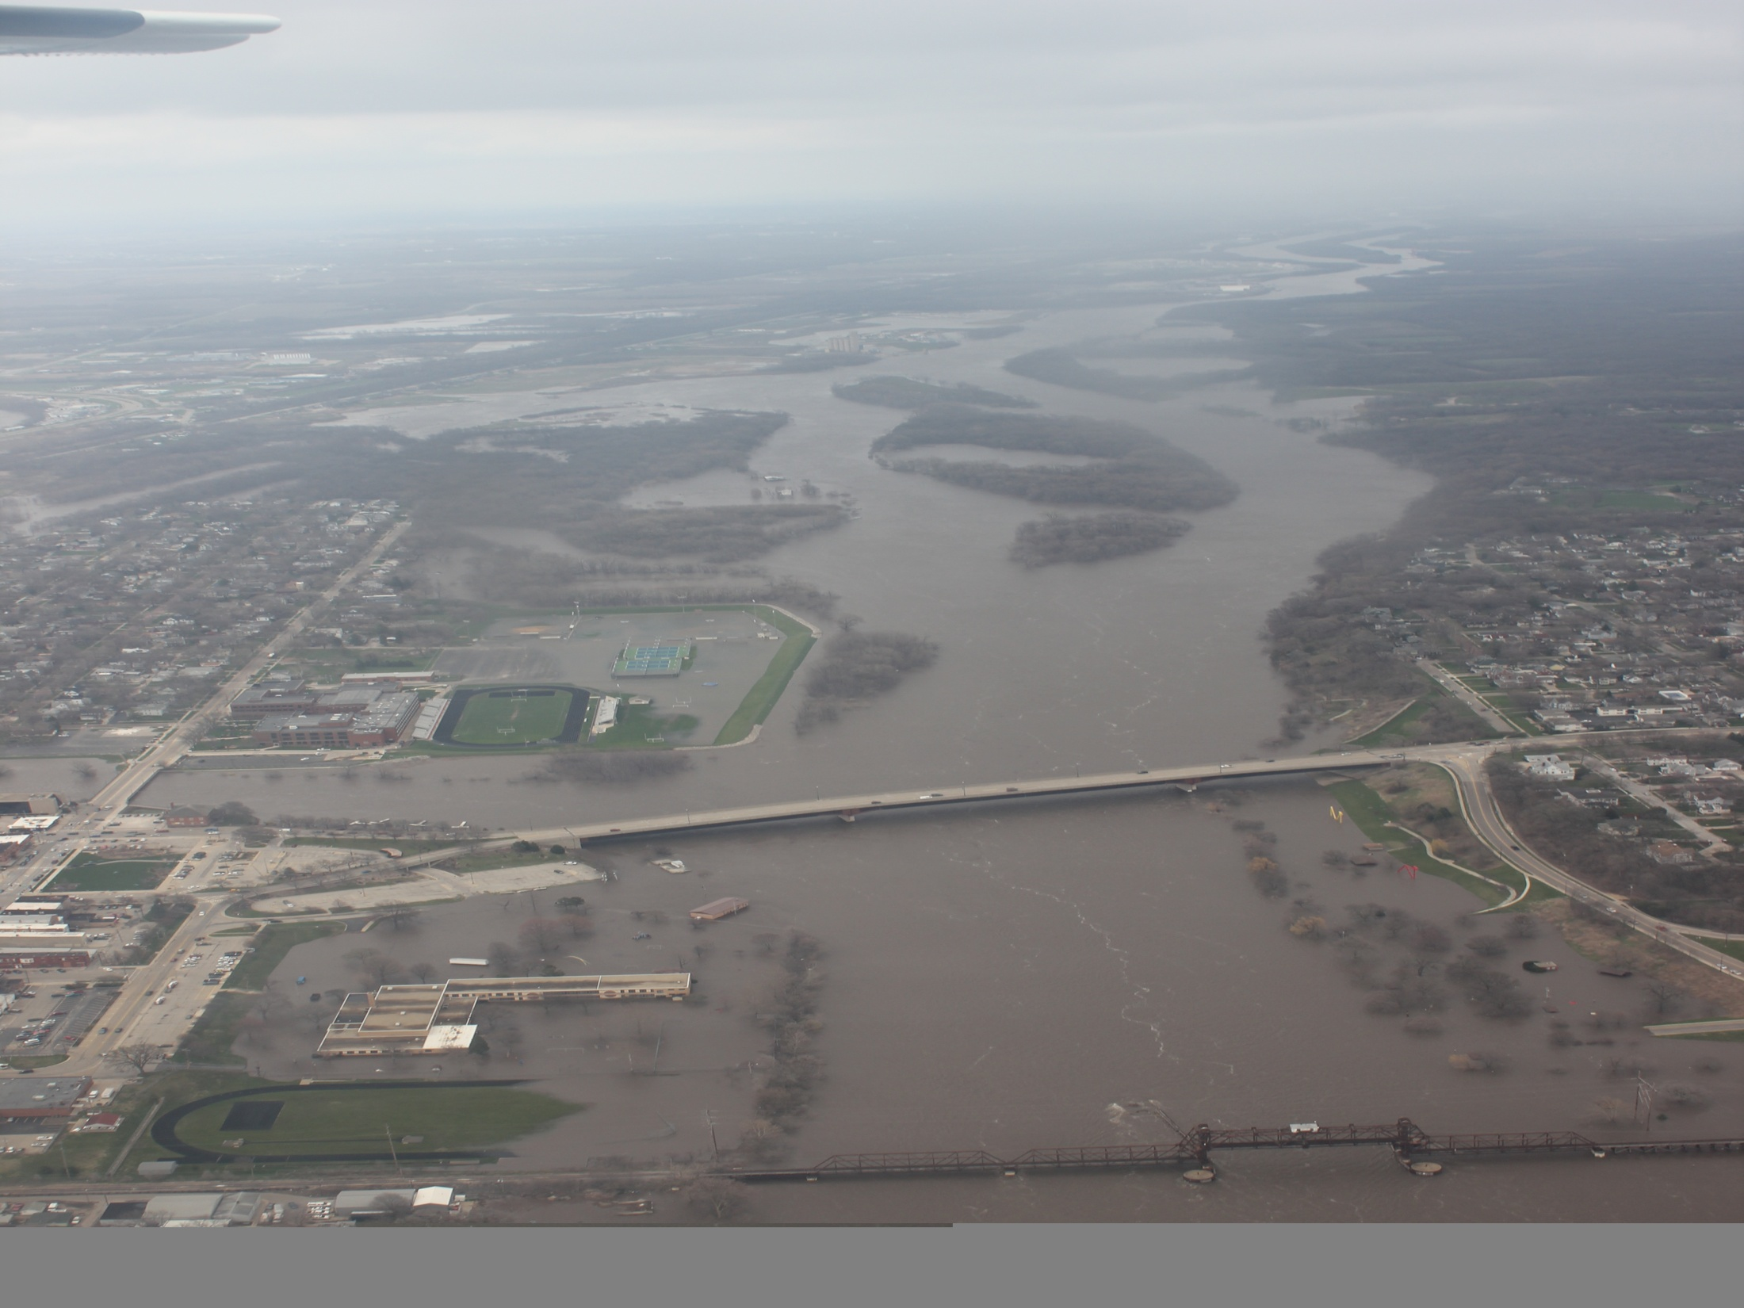
THE CHAMBER
OTTAWA AREA CHAMBER
OF COMMERCE & INDUSTRY

Slide 4
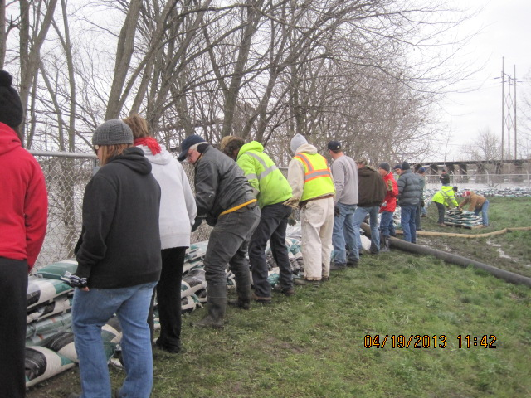

Slide 5
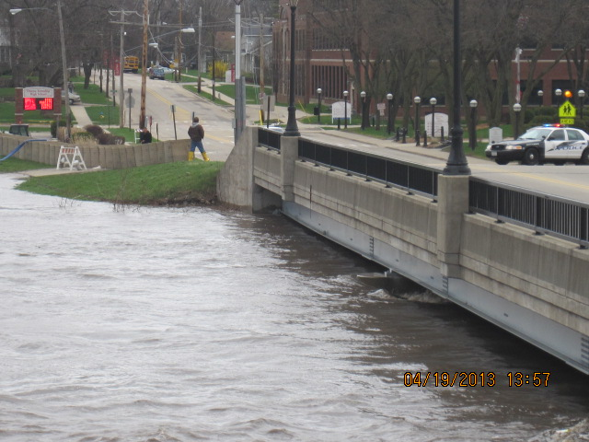

Slide 6
POLICE DEPARTMENT

Slide 7
Police Department Programs
Peer Jury
Child Abduction Response Team (CART)

Slide 8
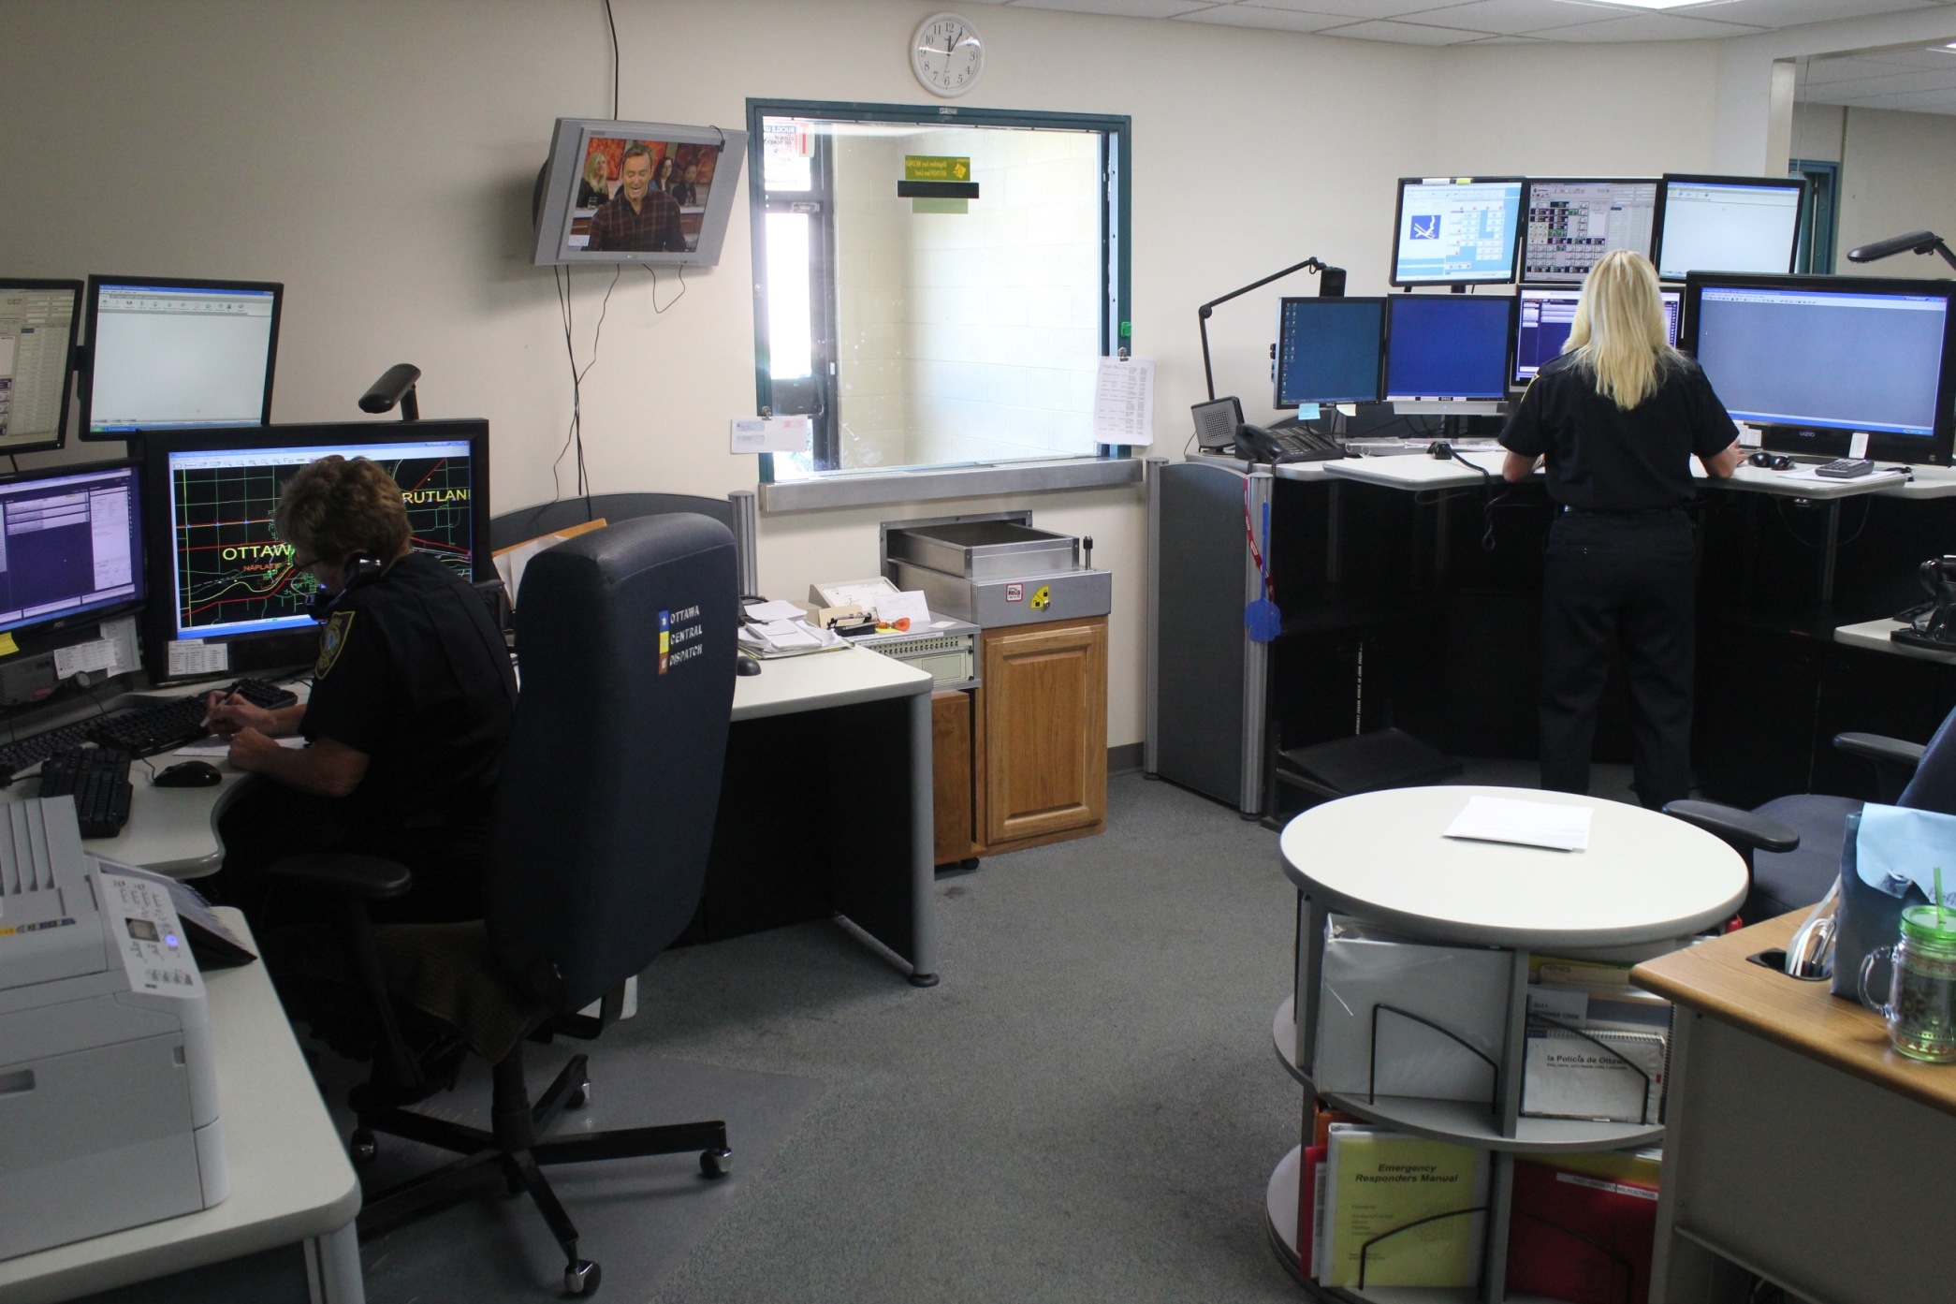
911 Center

Slide 9
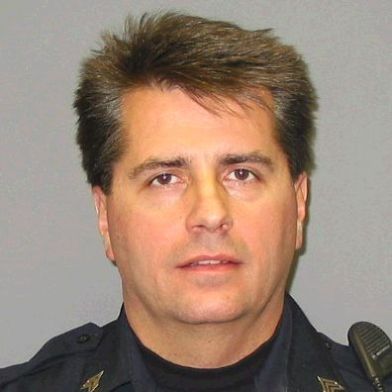
Retirement of
Detective Sgt. Randy Baxter

Slide 10
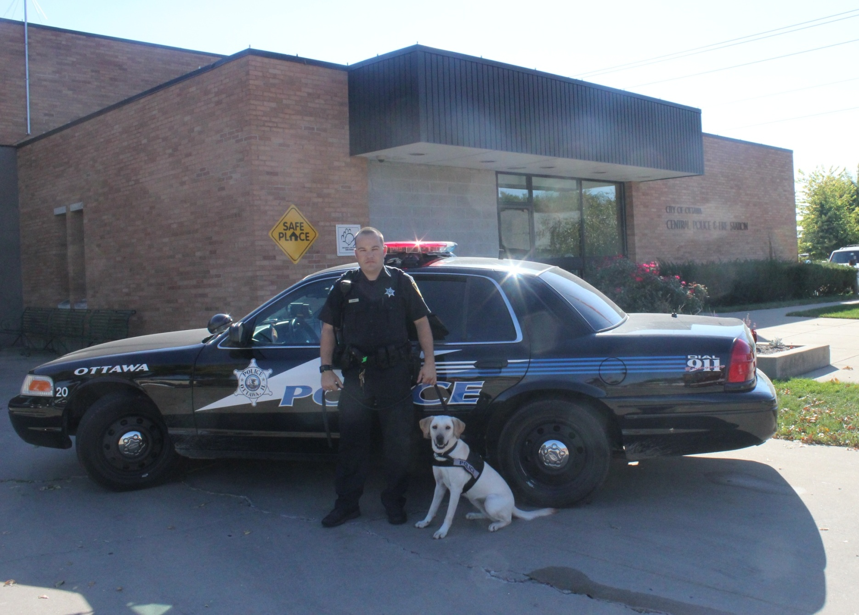
Robert Nilles and Gussy

Slide 11
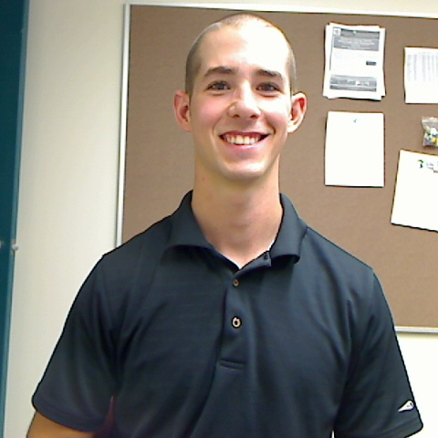
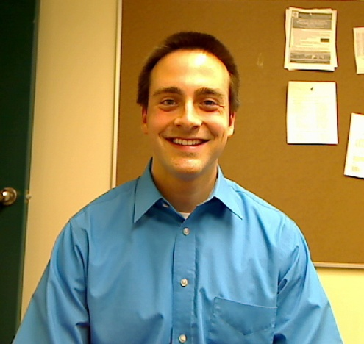
New Hires
Matt Najdanovich
Kevin Reynolds

Slide 12
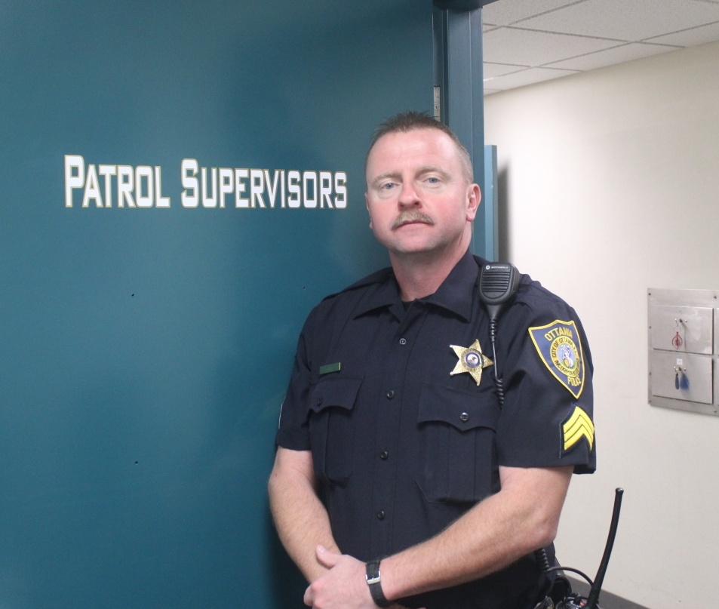
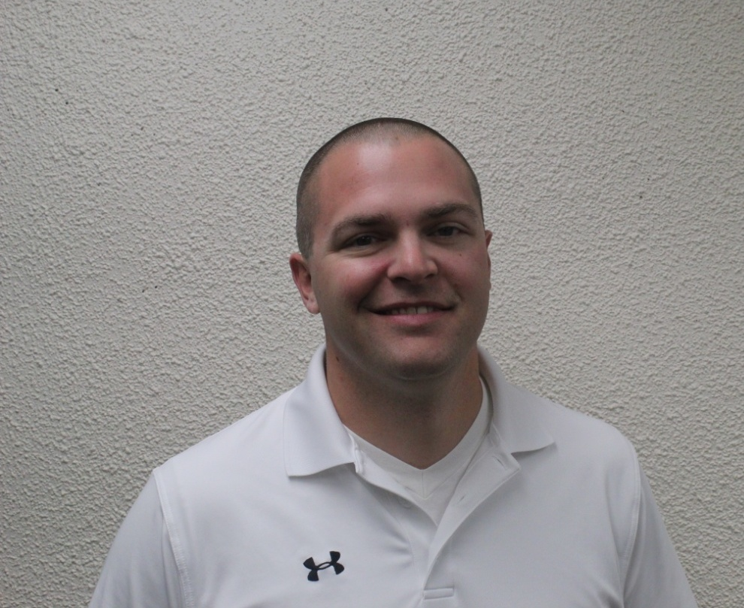
Promotions and Recognitions
Corporal Darrin Schmitz
Officer Mike Cheatham

Slide 13


Slide 14
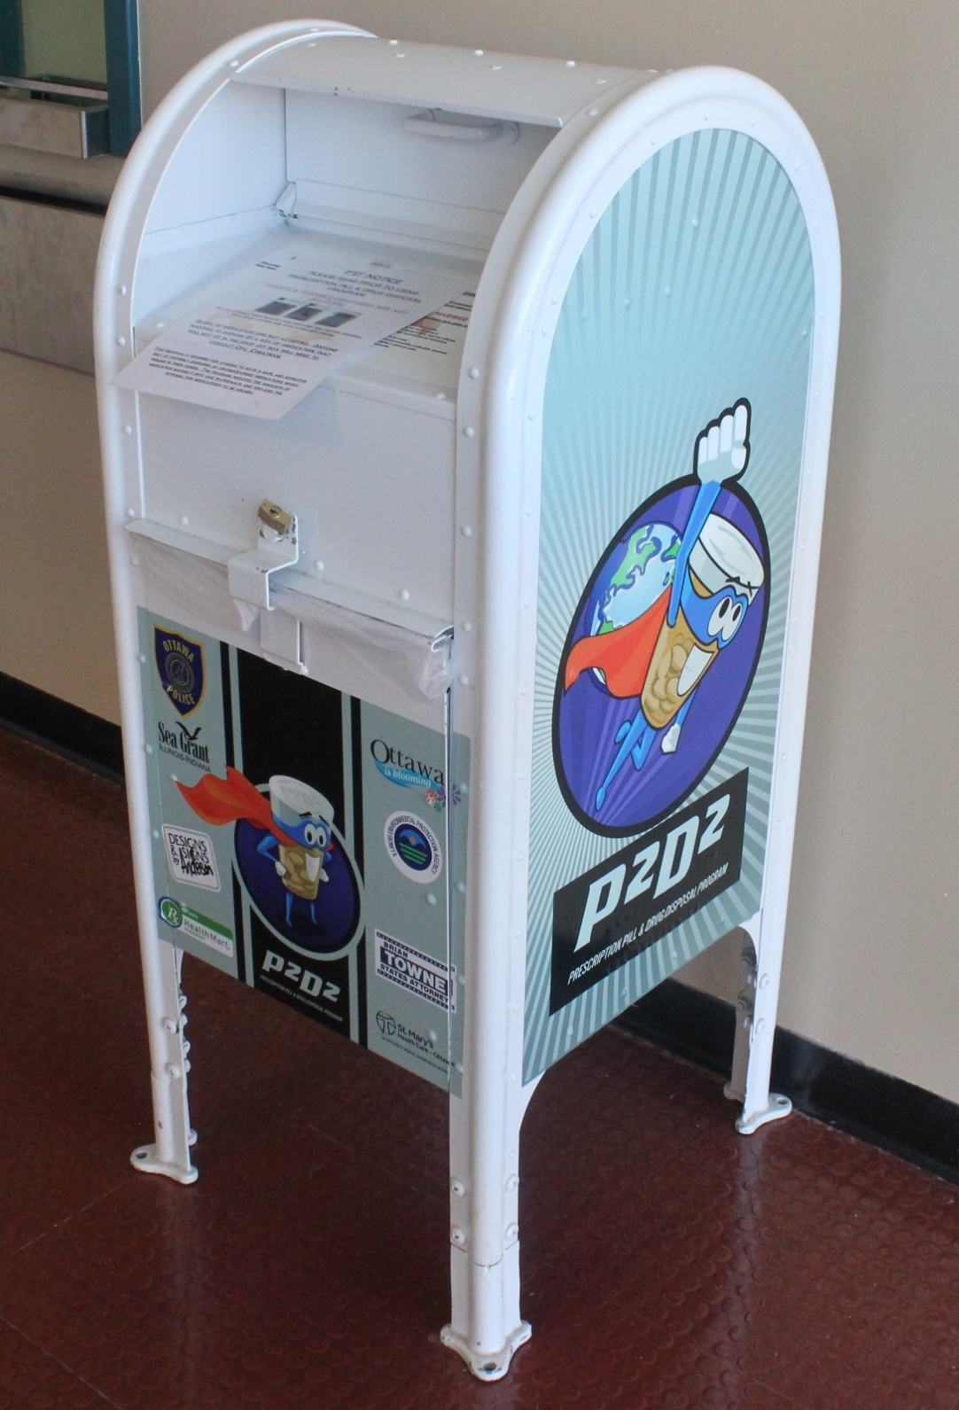
P2D2

Slide 15
FIRE DEPARTMENT

Slide 16
Retirements
Captain Ed Taylor
Captain William Manley
Firefighter Steve Bybee

Slide 17
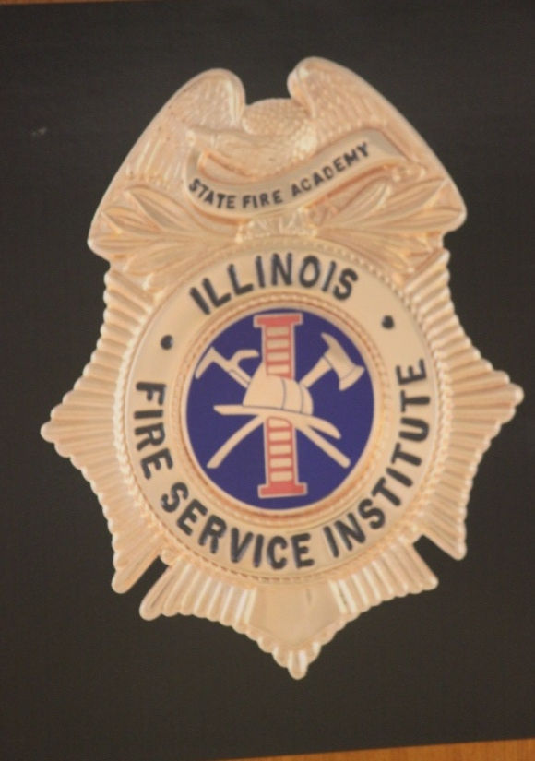
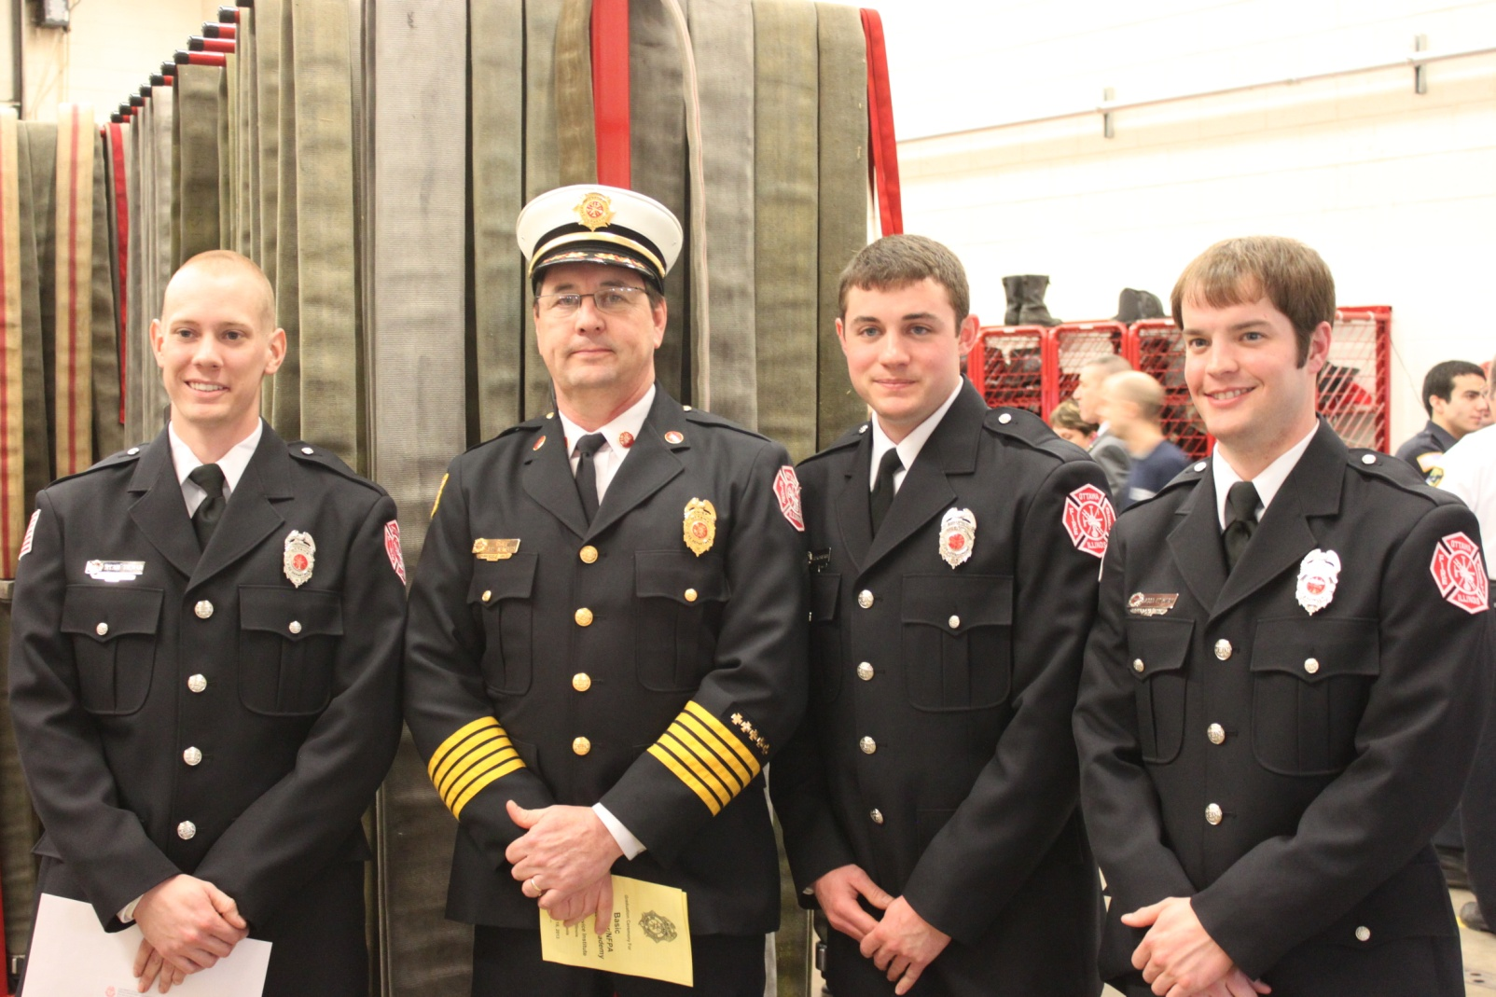
New Hires

Slide 18
Class 3 ISO Fire Rating
Improvements in Water Supply Systems
Increased Training of the Fire Department
Improvements in the Communications Center

Slide 19
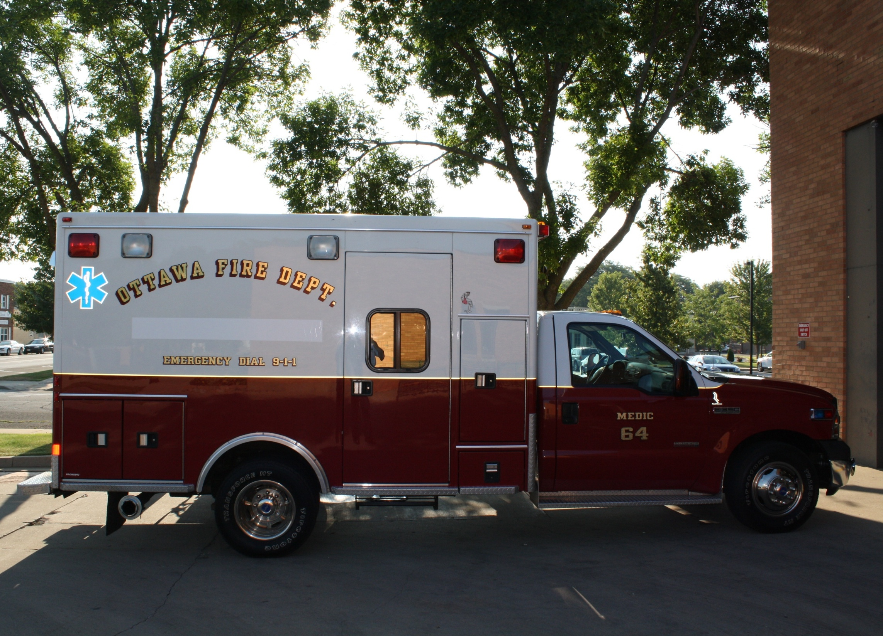

Slide 20

Fire Department

Slide 21
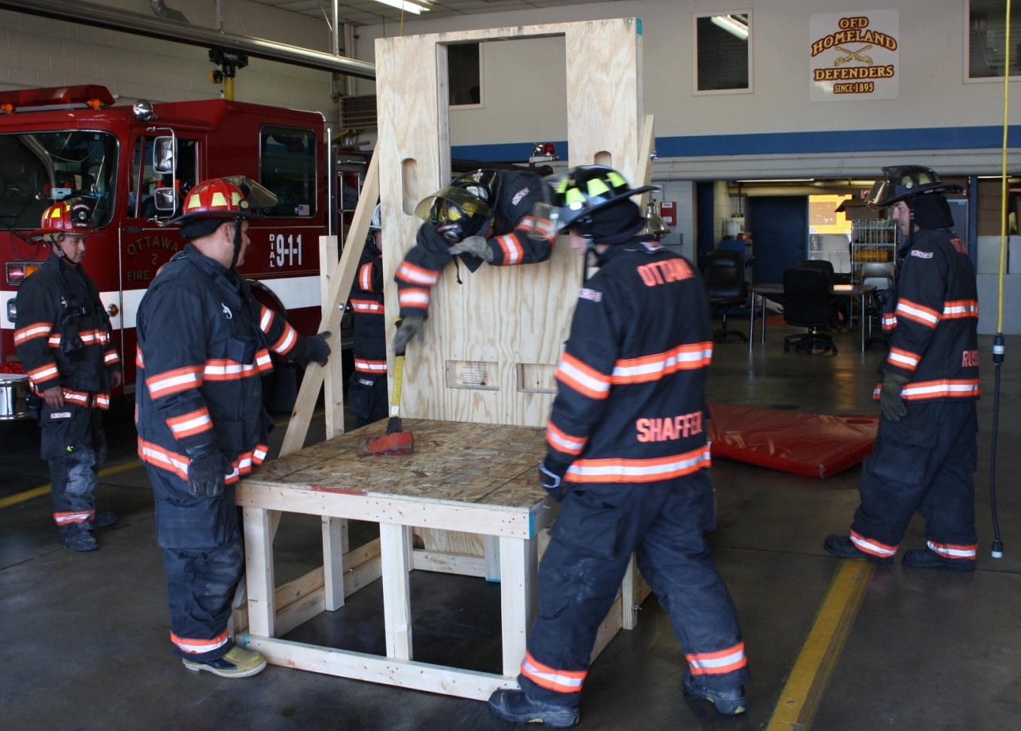
Training

Slide 22
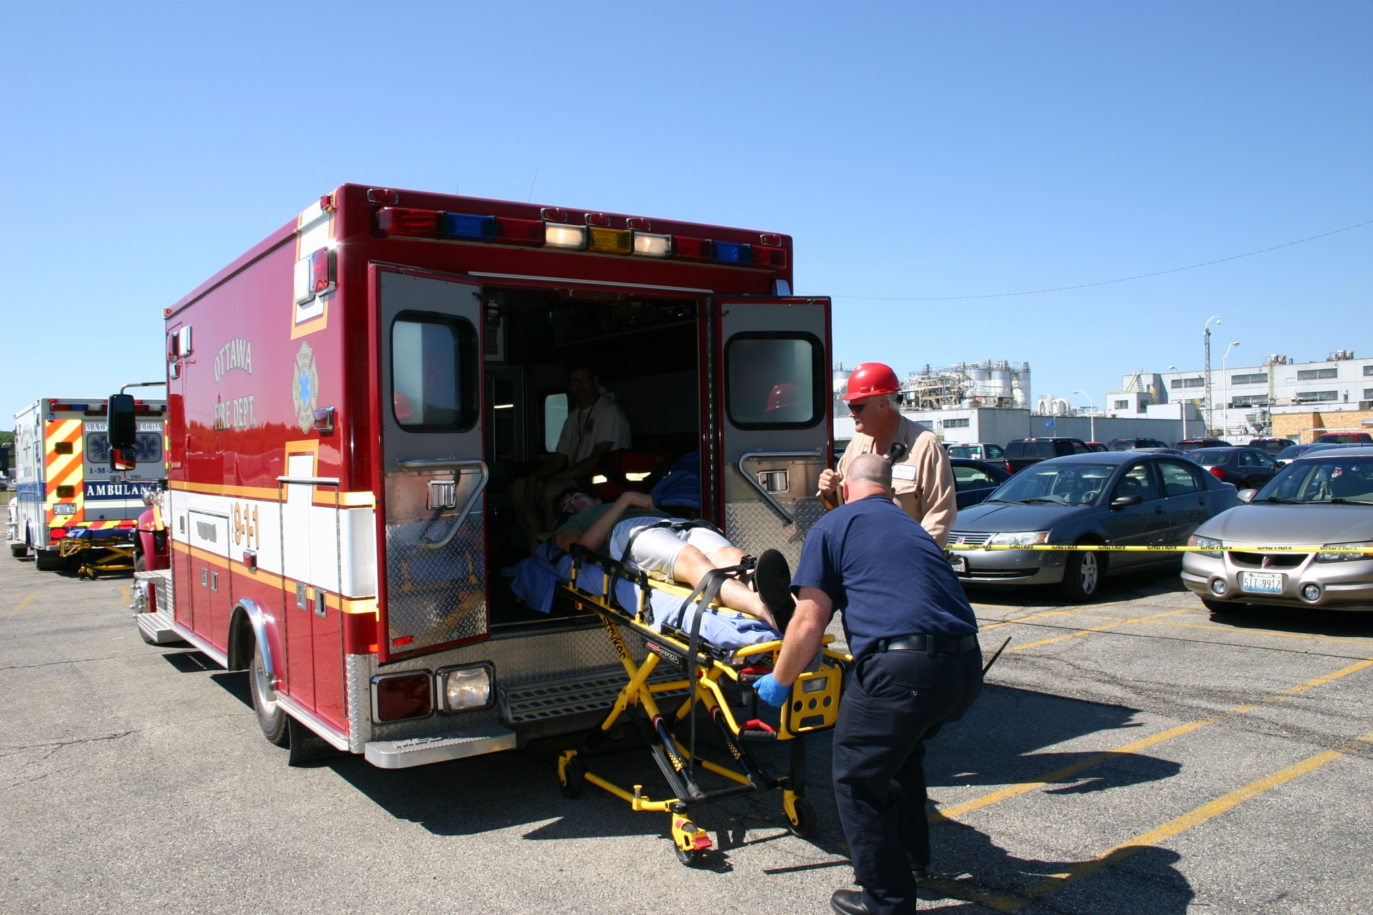
Disaster Drill

Slide 23

State of Illinois’
Urban Search
& Rescue

Slide 24
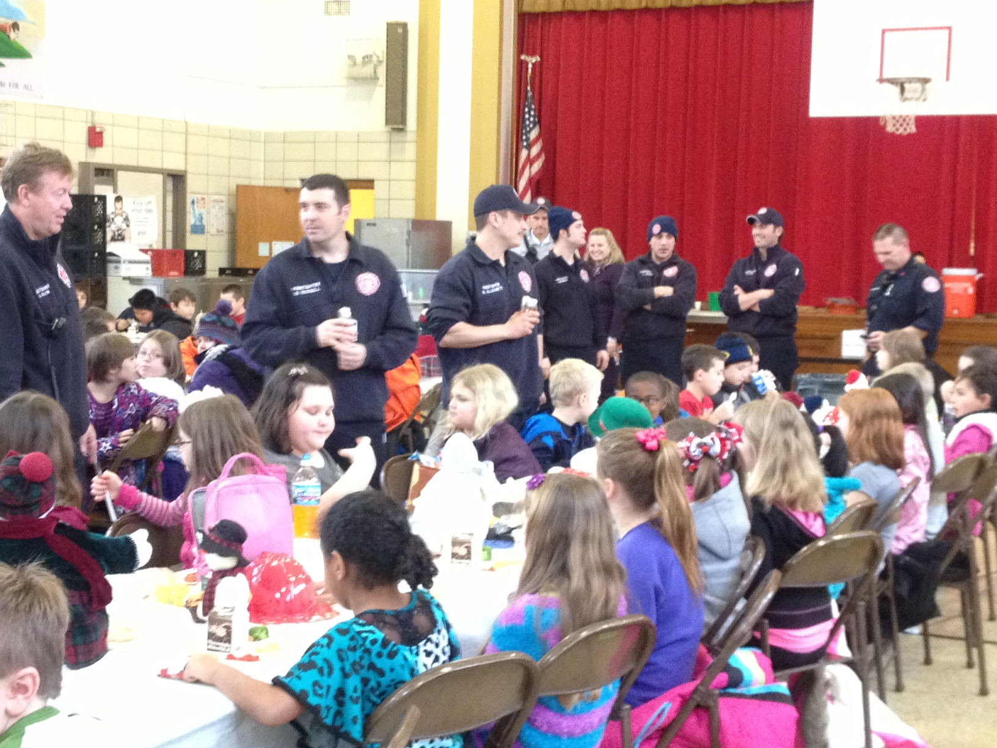
Fire Prevention and Education

Slide 25
PUBLIC WORKS
WATER DIVISION

Slide 26
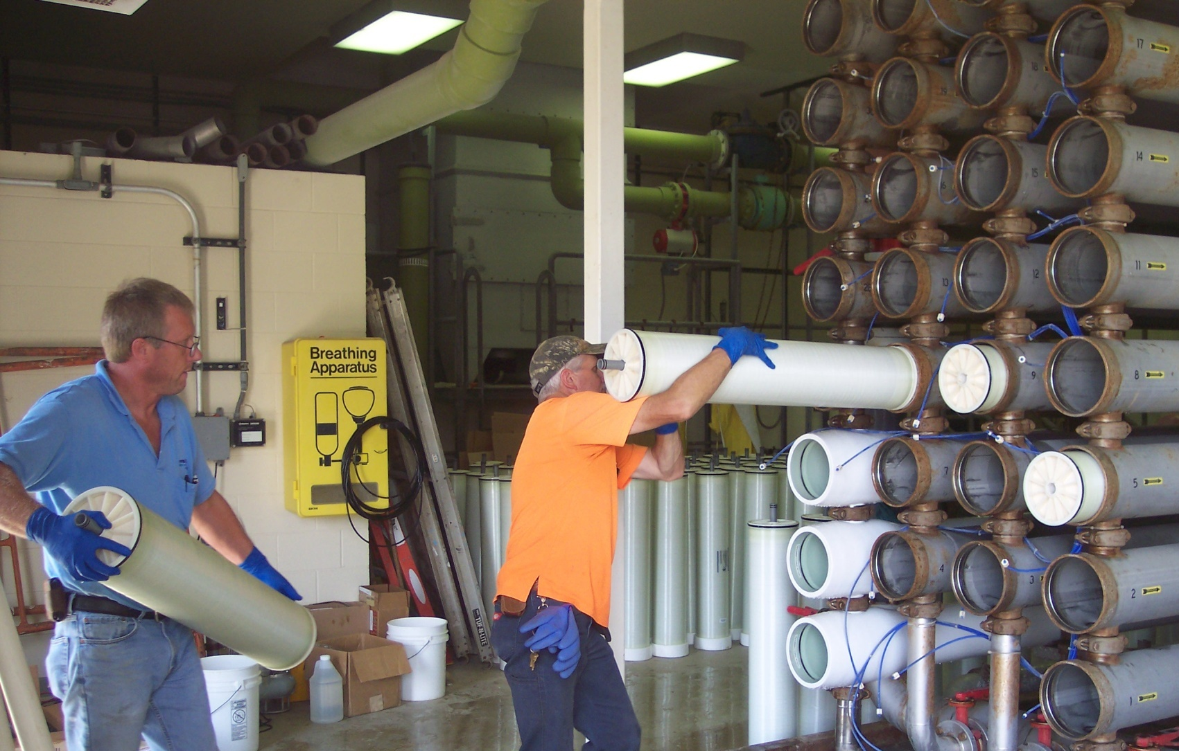
Membrane Filters

Slide 27
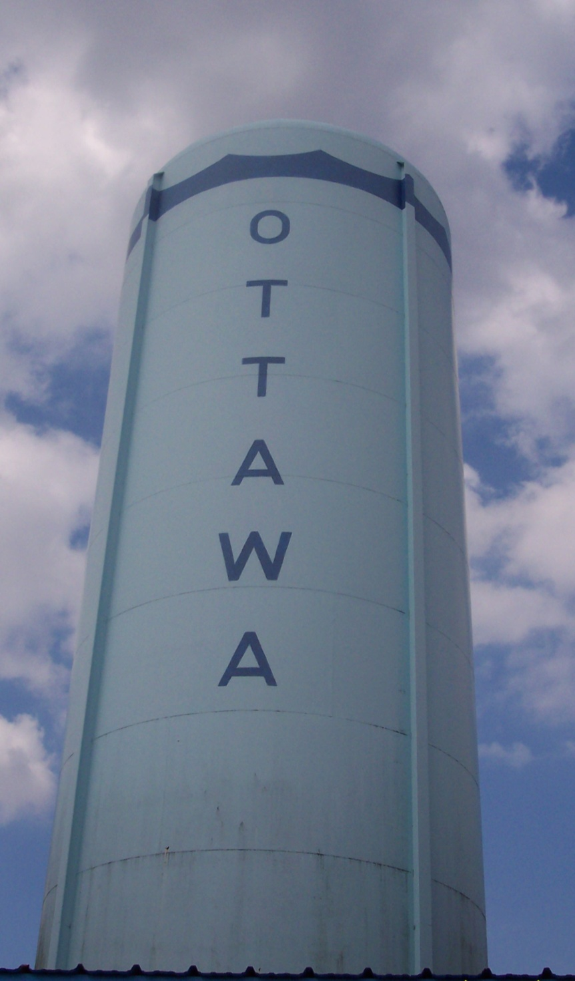
Standpipe
BEFORE

Slide 28
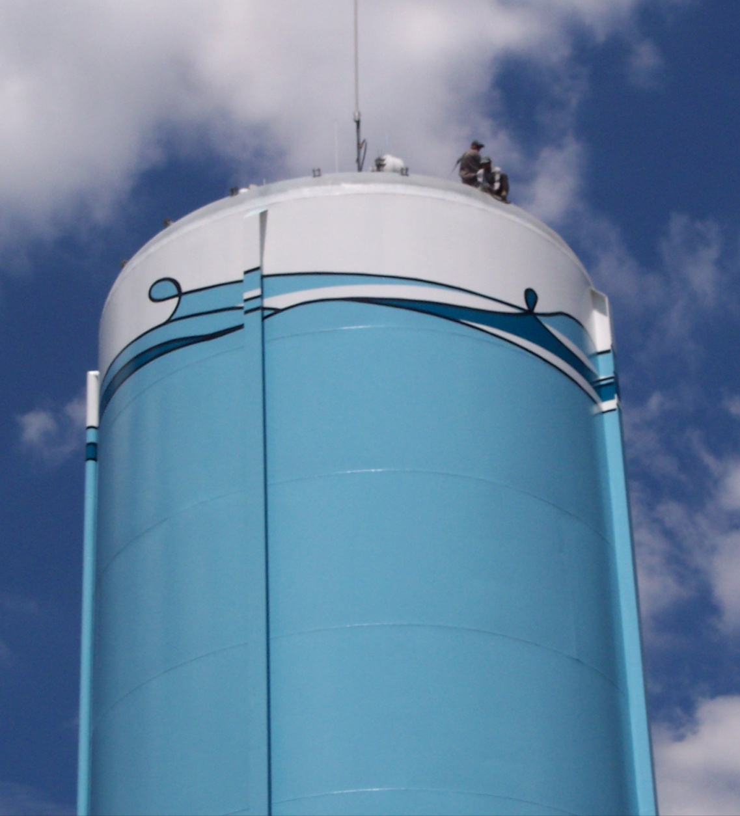
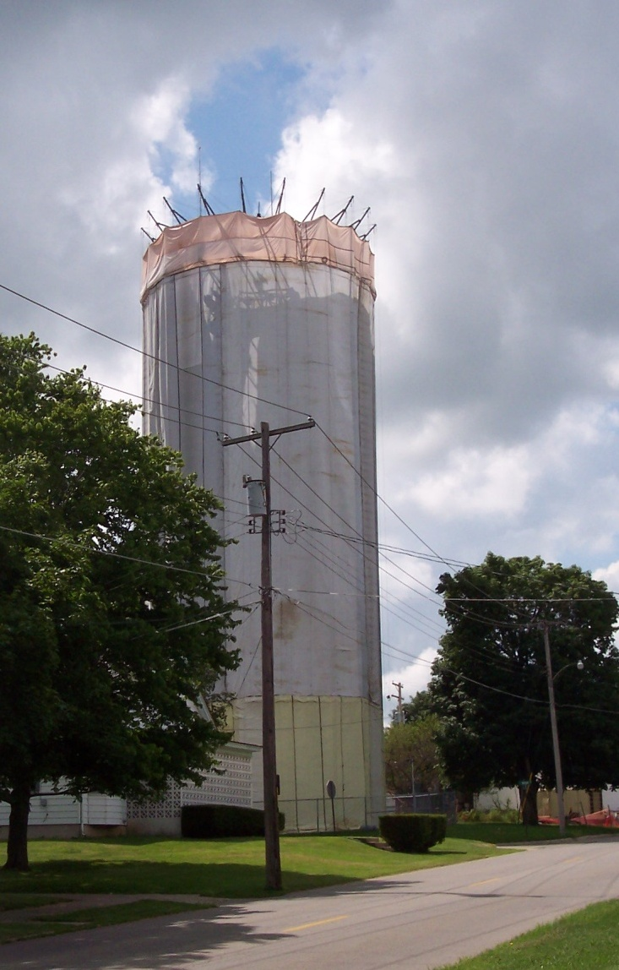
Standpipe
AFTER

Slide 29
Paperless or Automatic
Bill Payment
Contact:
email waterbilling@cityofottawa.org
or
Call 815-434-0158

Slide 30
PUBLIC WORKS
WASTEWATER DIVISION

Slide 31
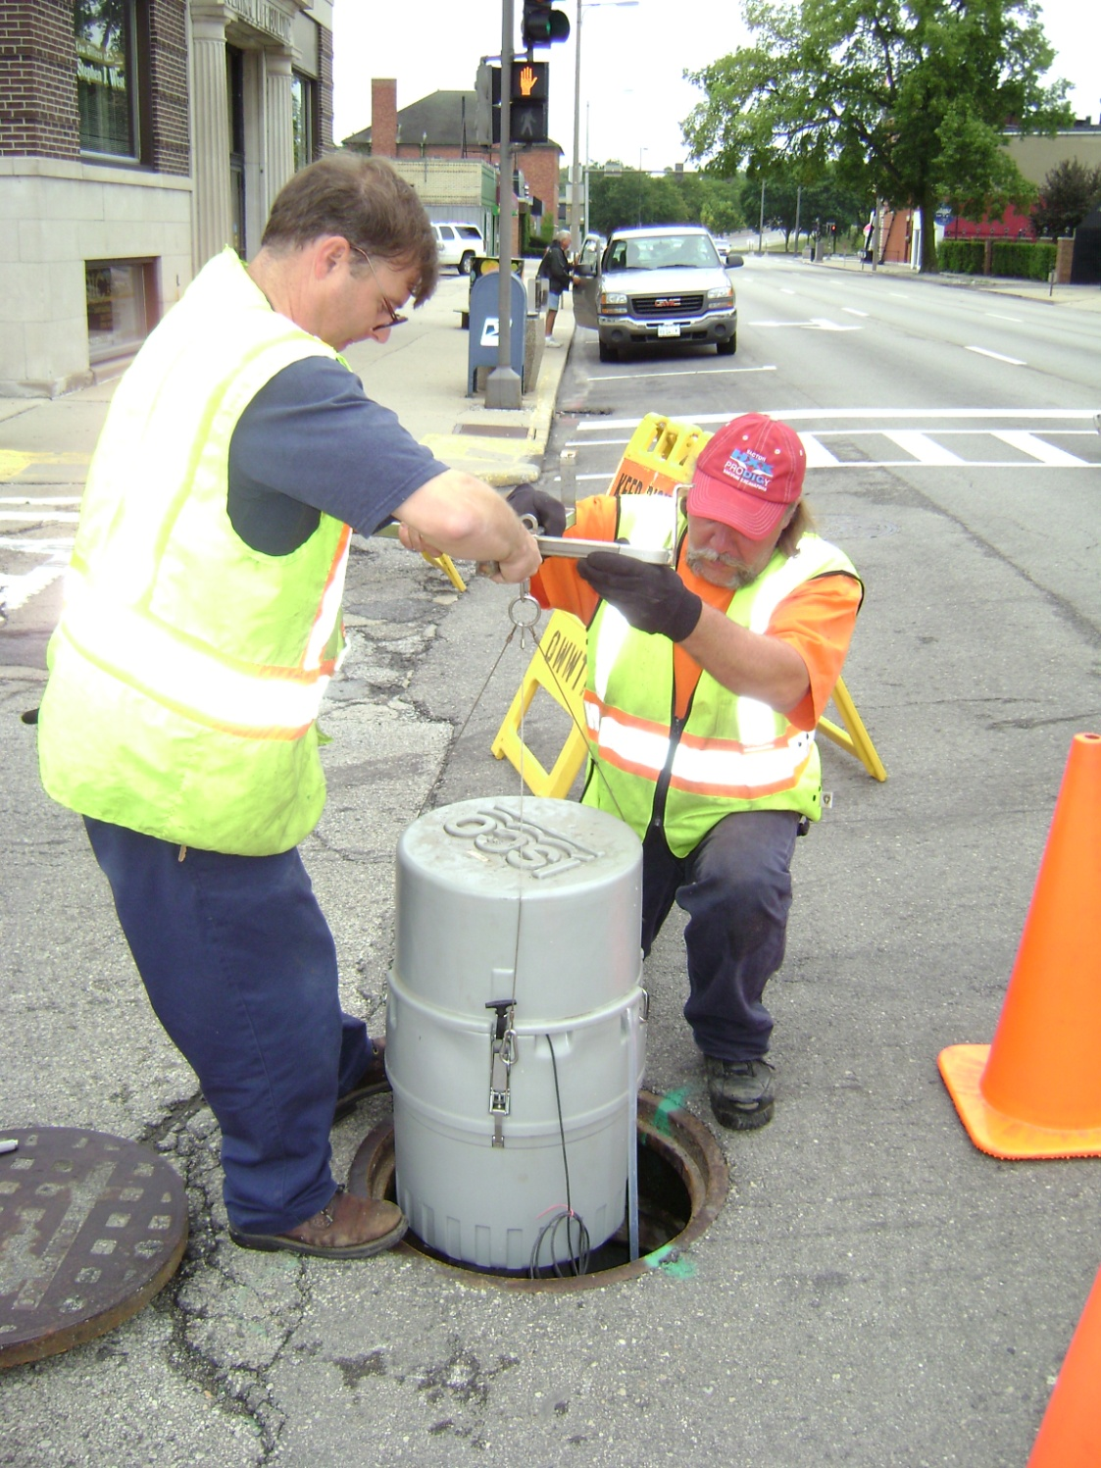
Sewer
Meter

Slide 34
Sewer Televising

Slide 36

Sump Pump Discharge

Slide 37
PUBLIC WORKS
STREETS DIVISION

Slide 38
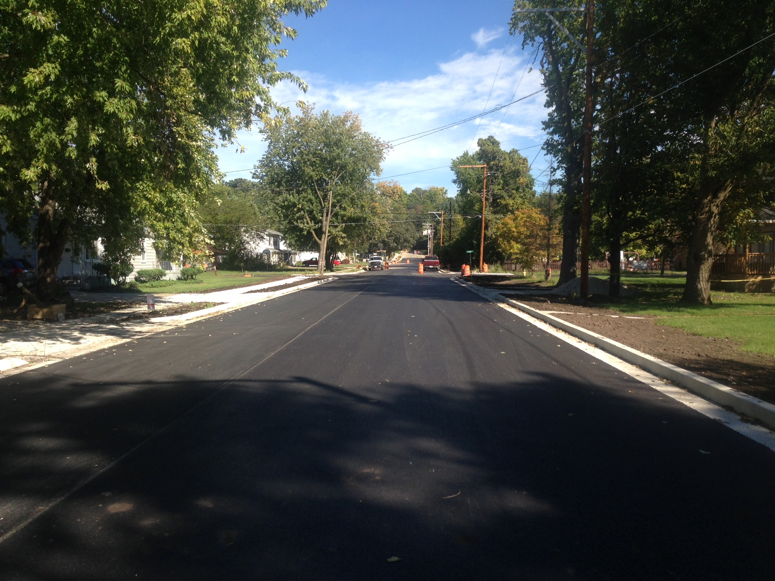
Poplar Streets

Slide 39
Resurfaced 24 blocks of streets
Replaced 10 blocks of crumbling curbs
Improved leaf yard waste drop off

Slide 40
Public works
Parks division and
Playground and recreation board

Slide 41
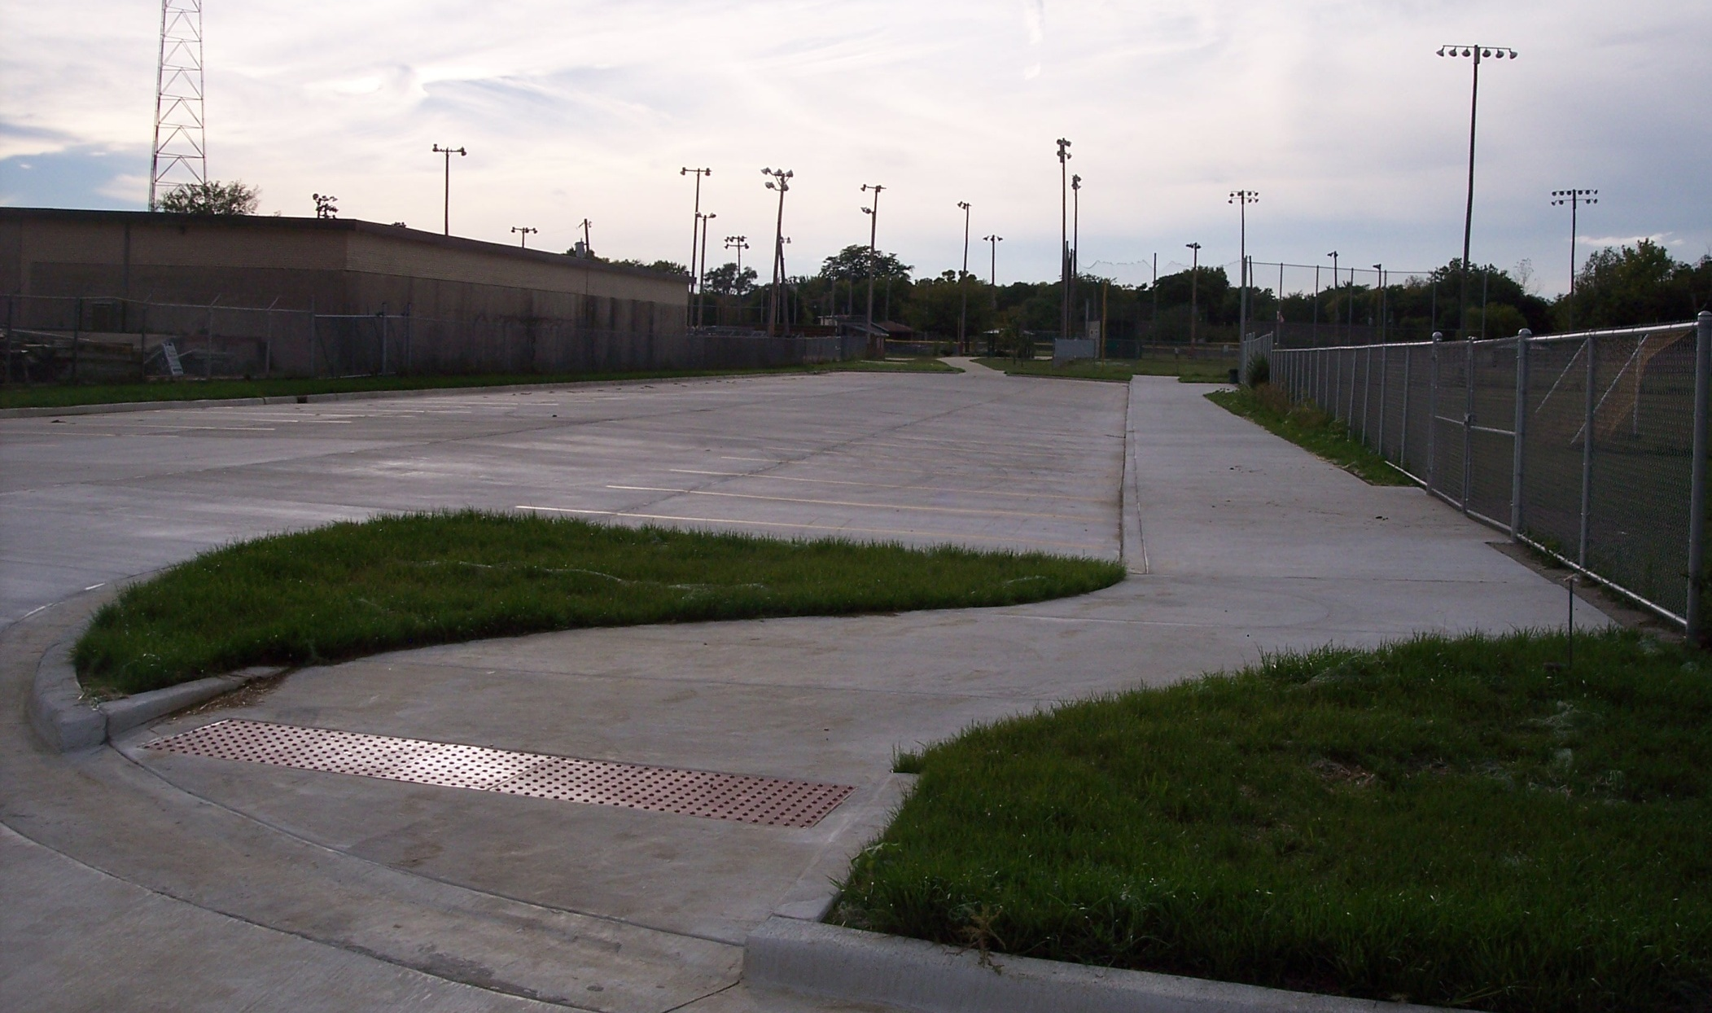
Lincoln Douglas
New Parking Lot

Slide 42
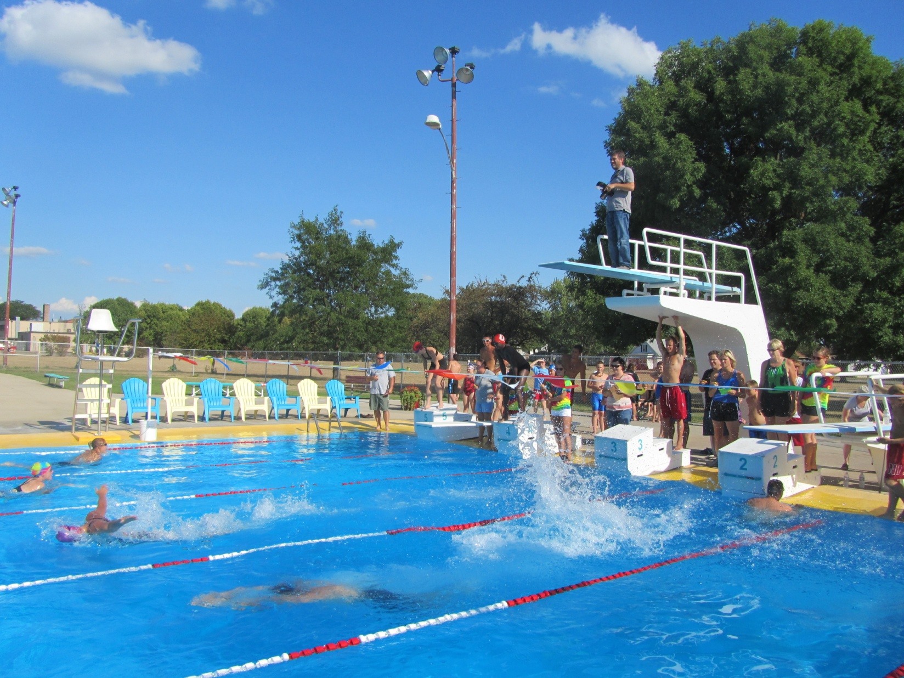
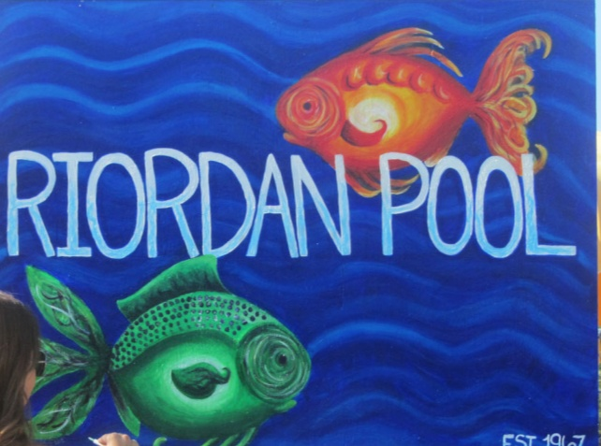

Slide 43
Parks

Slide 44
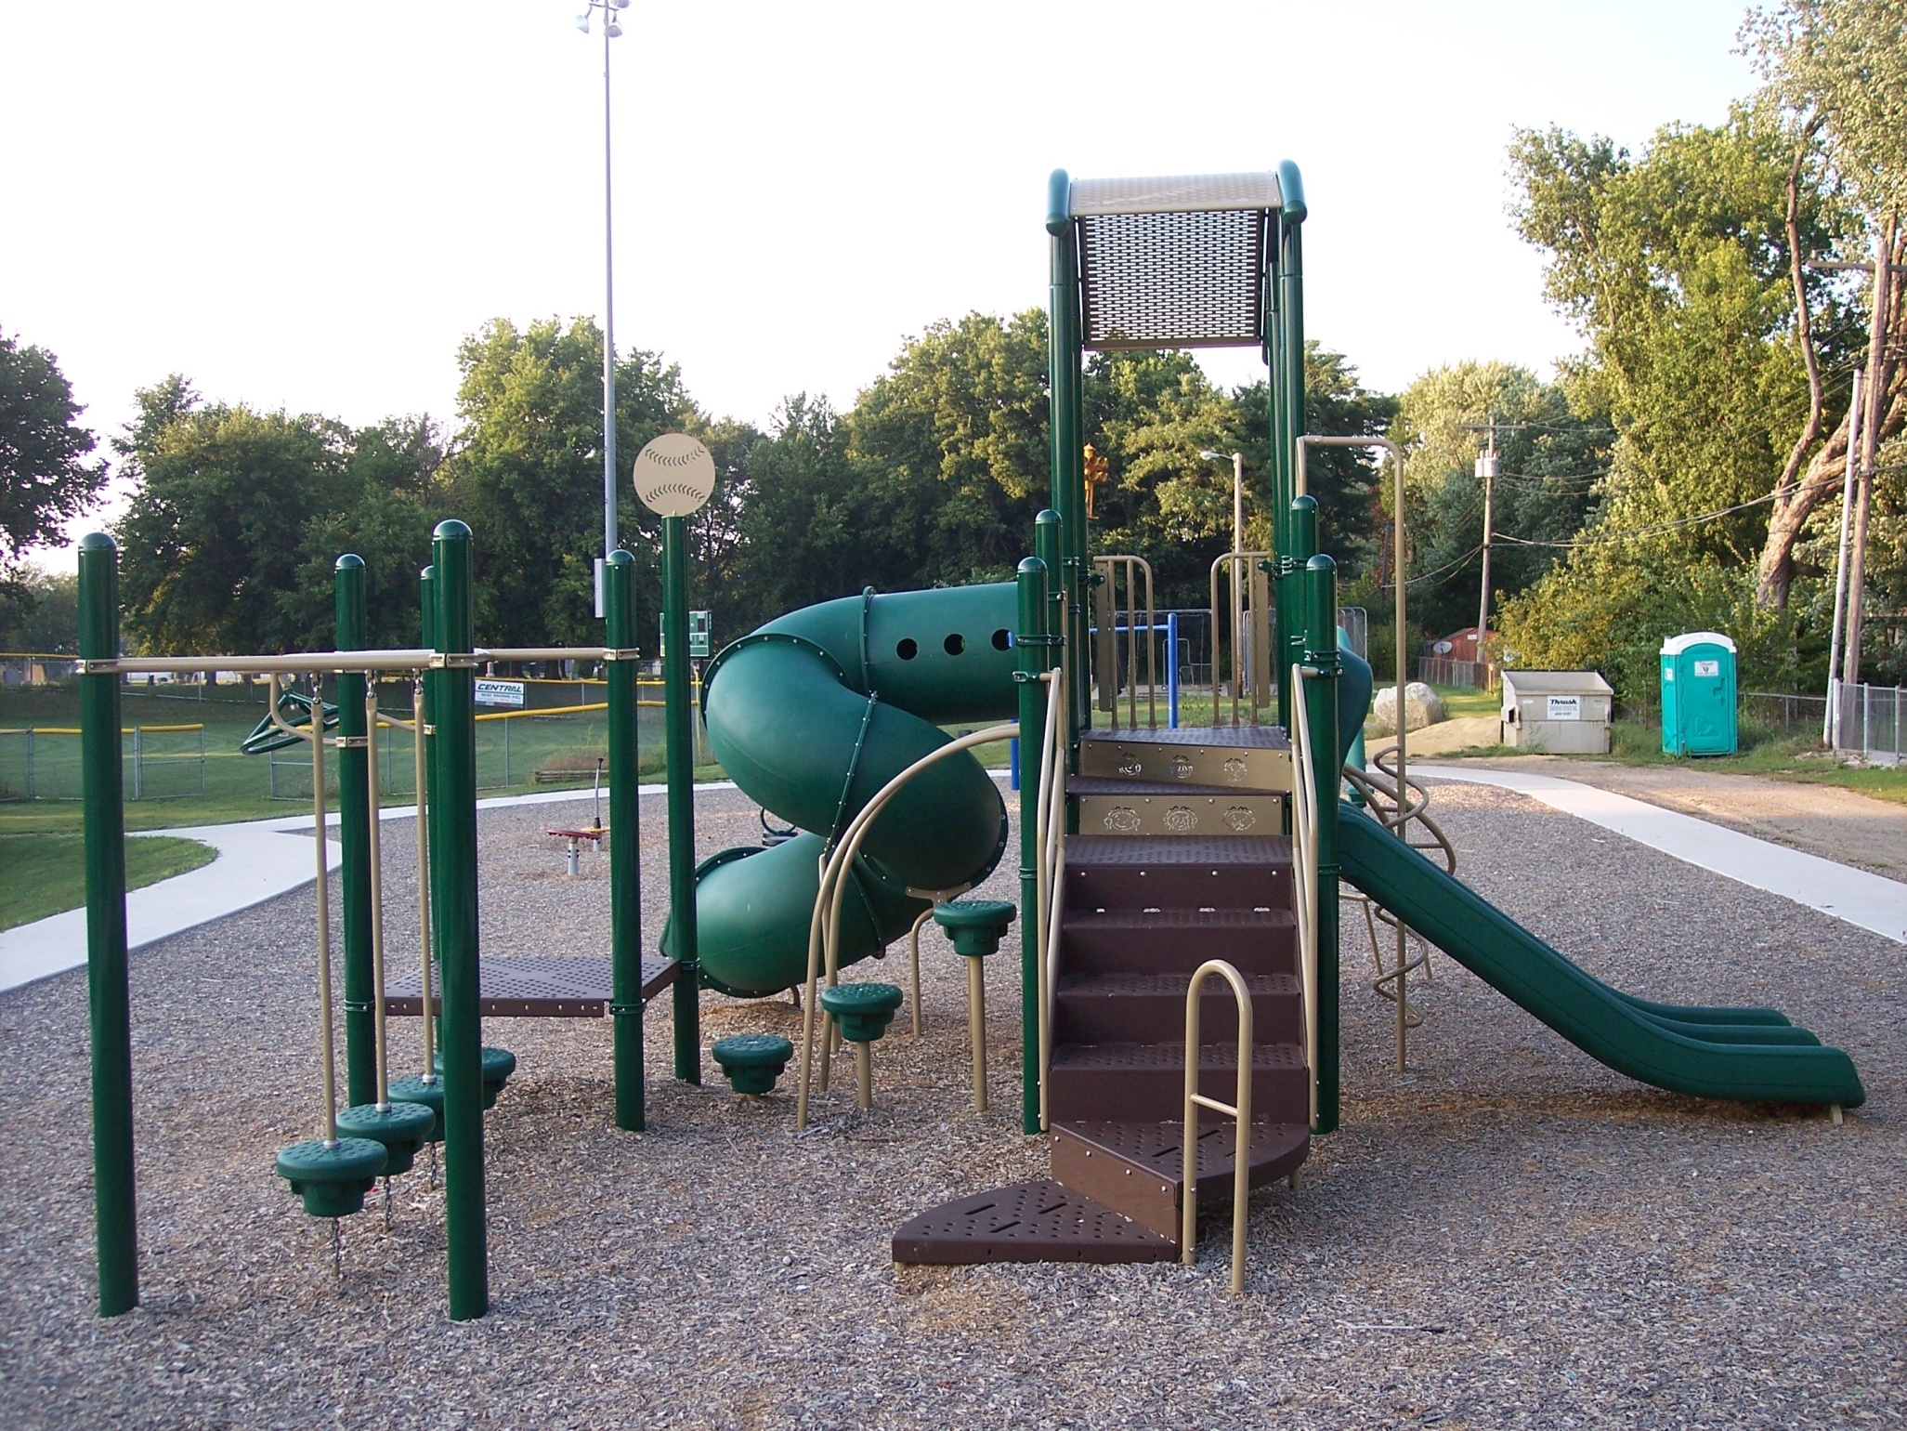
Varland Park

Slide 45
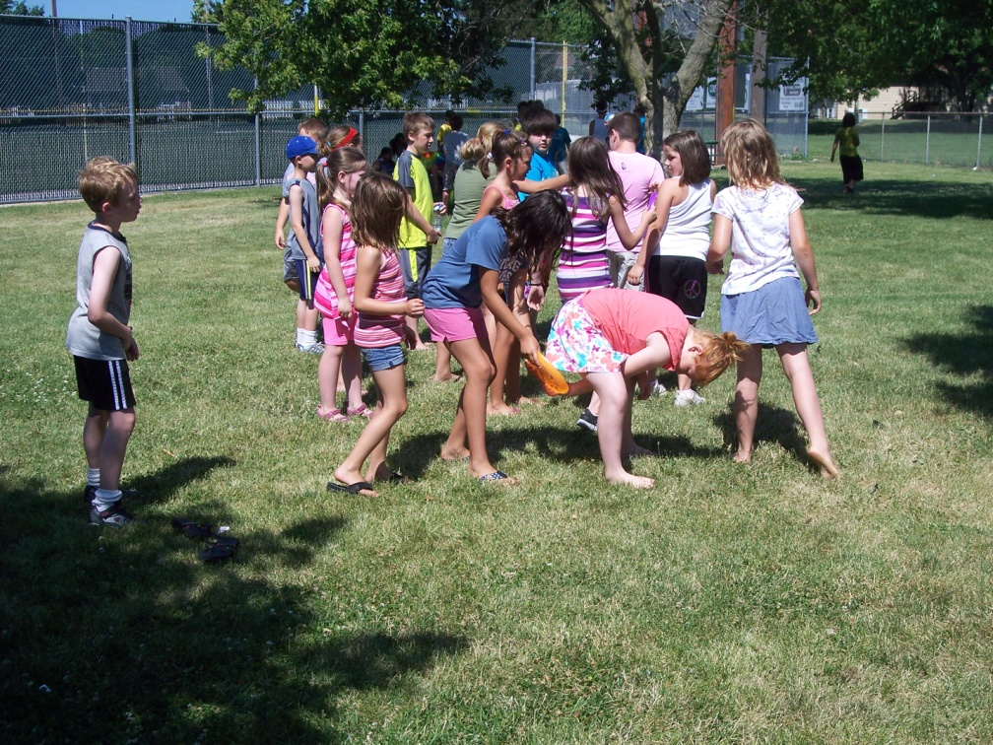
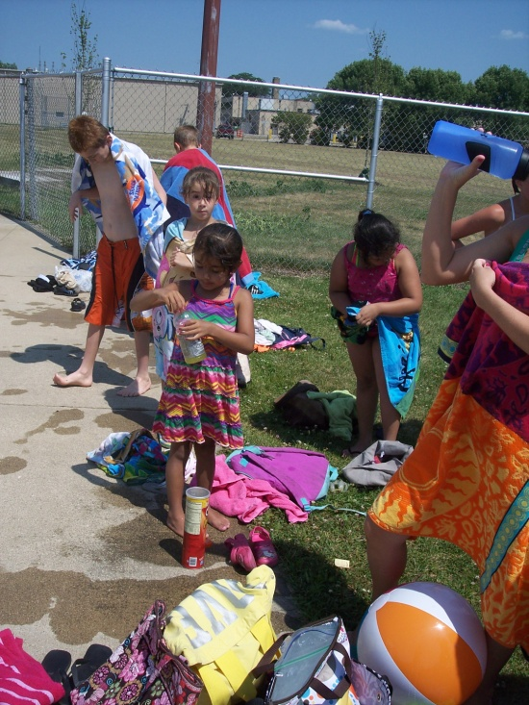
Programs

Slide 46
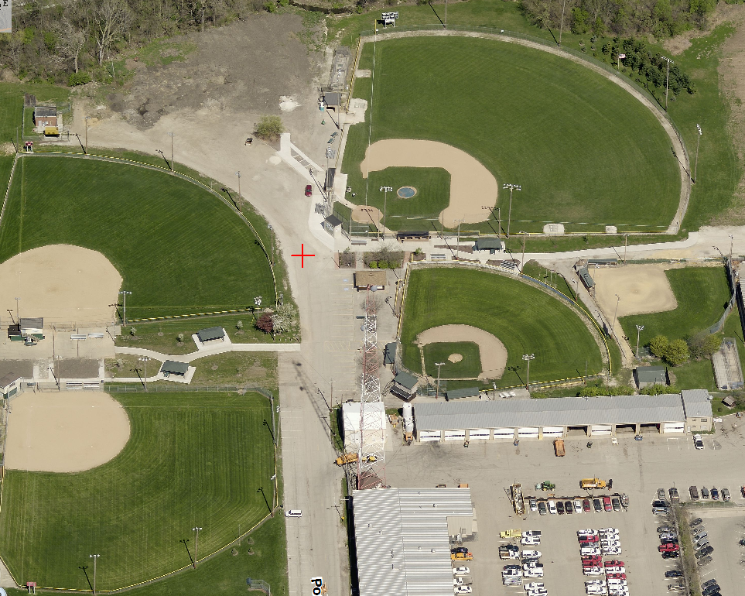

Slide 47
Adult Recreation
Dance Lessons
Sunrise Yoga
Harvest Dance

Slide 48
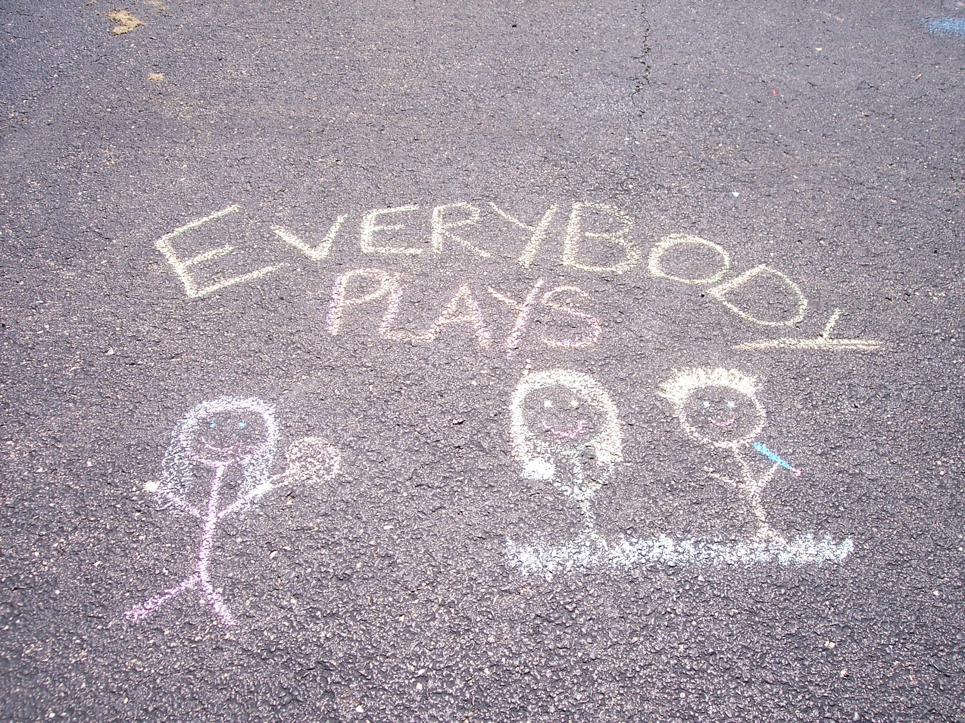

Slide 49
NORTH CENTRAL
AREA TRANSIT
(NCAT)

Slide 50
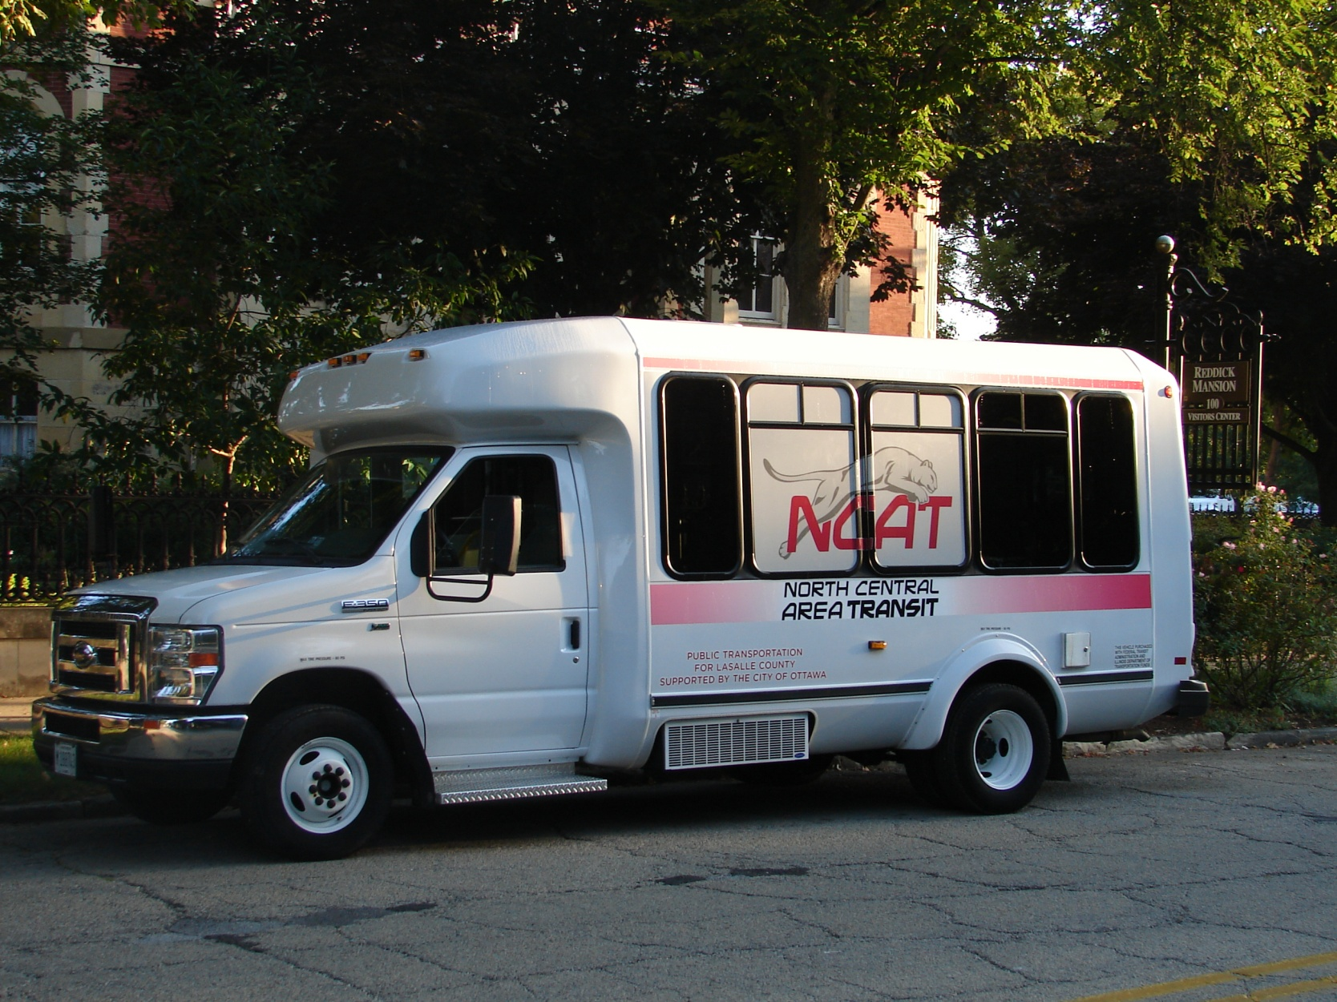

Slide 51
BROADBAND

Slide 52
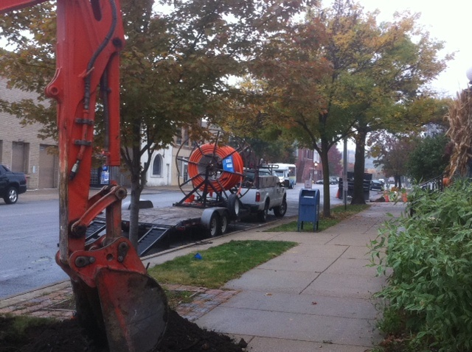
Broadband

Slide 53

Broadband Access

Slide 54
LED CITY STREET LIGHTING

Slide 55
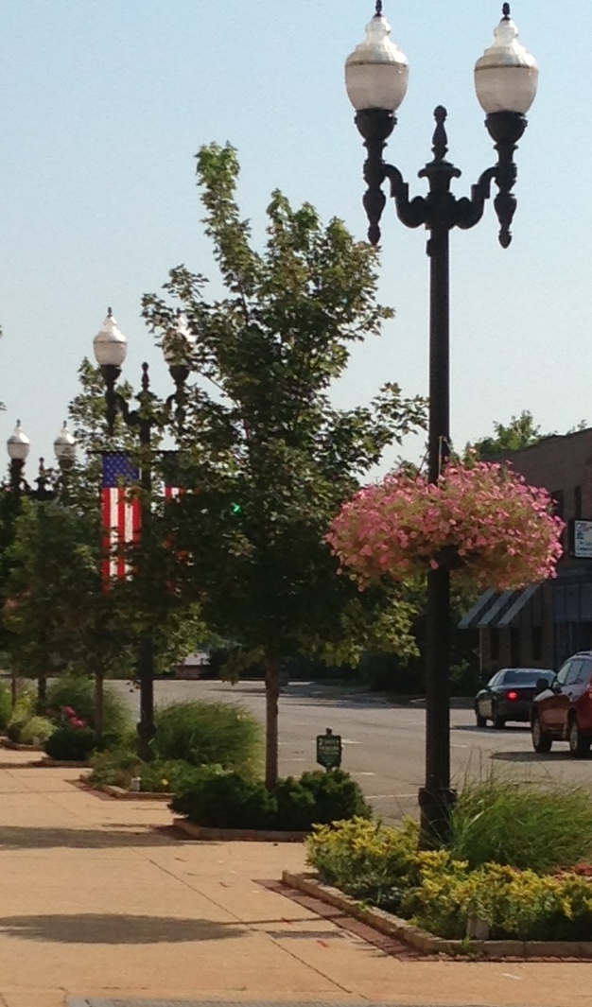
LED City
Street Lights

Slide 56
FOX RIVER FLATS
BUY-OUT PROGRAM

Slide 57
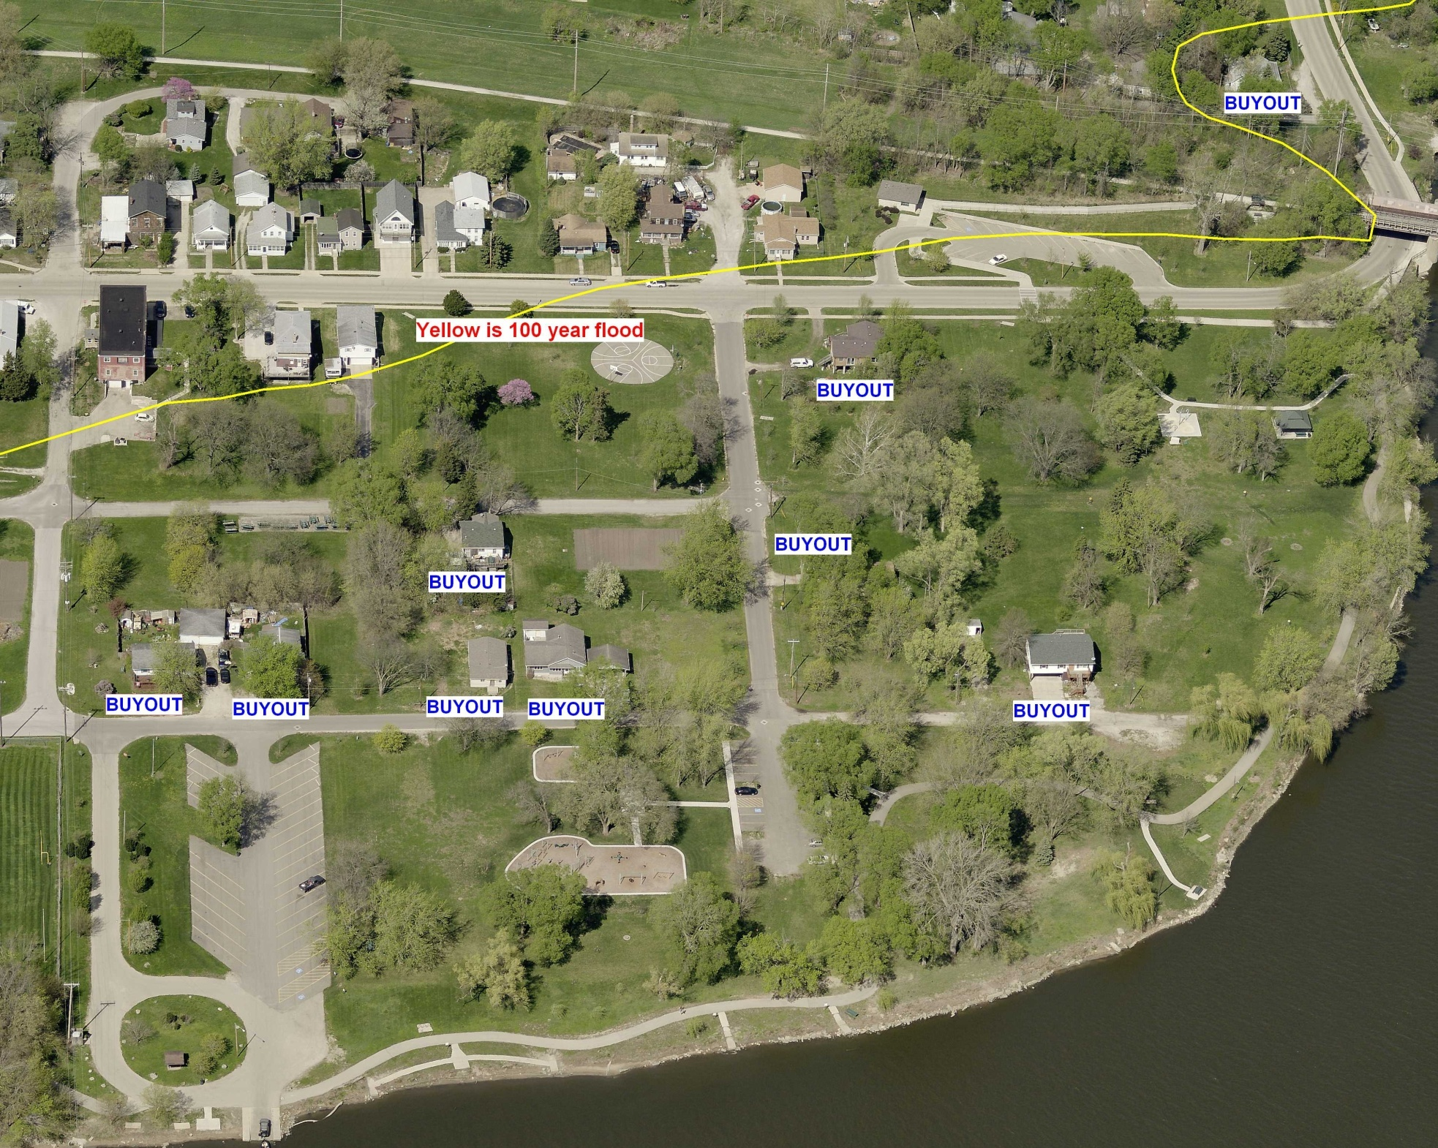
Fox River/Flats Buy-out $972,000

Slide 58
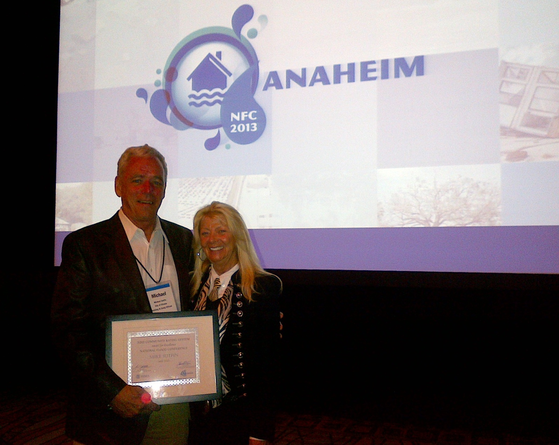
Mike Sutfin received
2012 CRS Award for Excellence

Slide 59
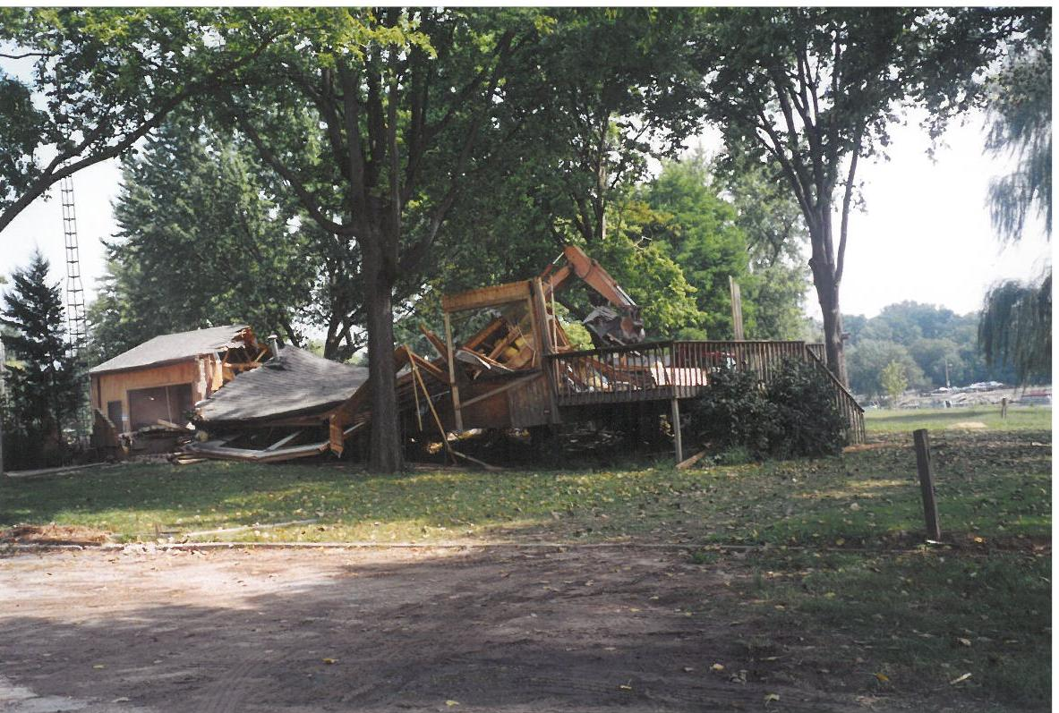

Slide 60
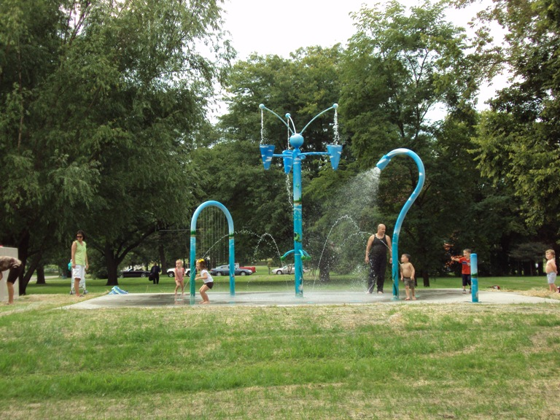
FOX RIVER PARK WATER FEATURE

Slide 61
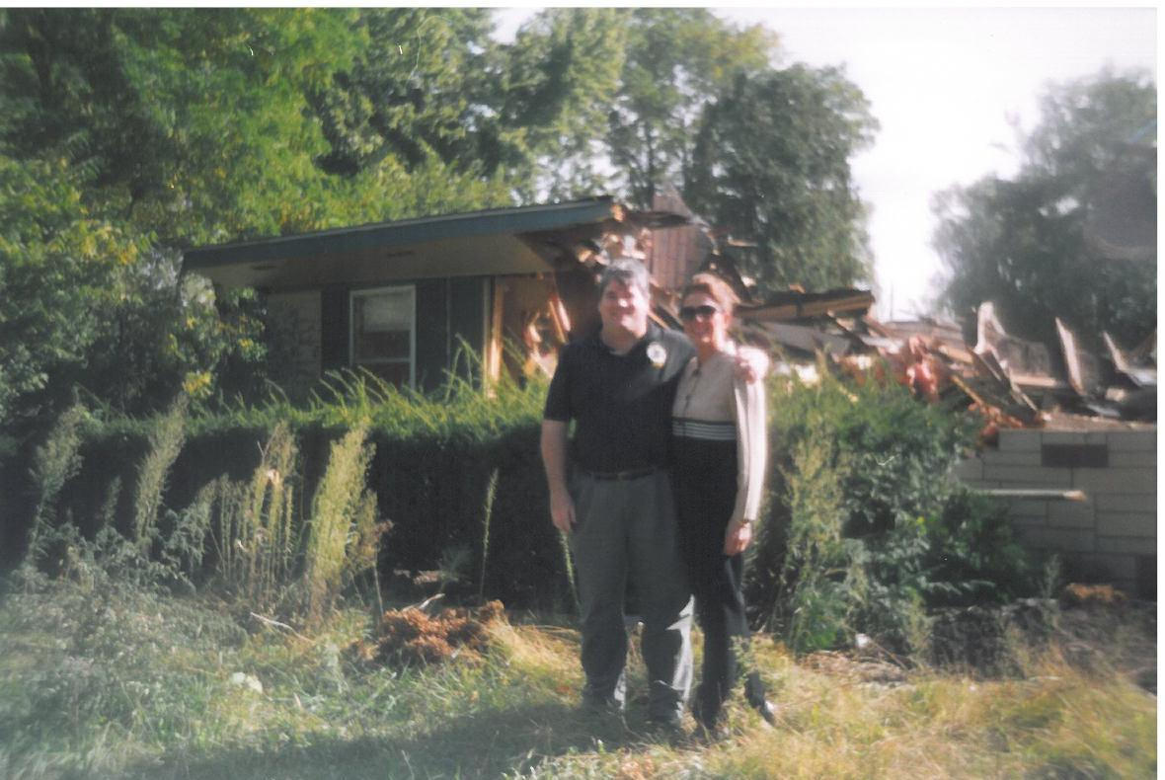
August 2000

Slide 62
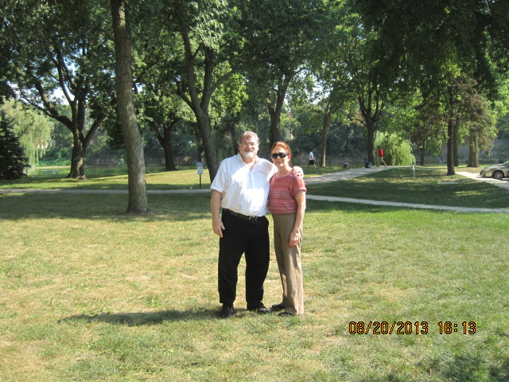

Slide 63
CONSTRUCTION
AND
DEVELOPEMENT

Slide 64
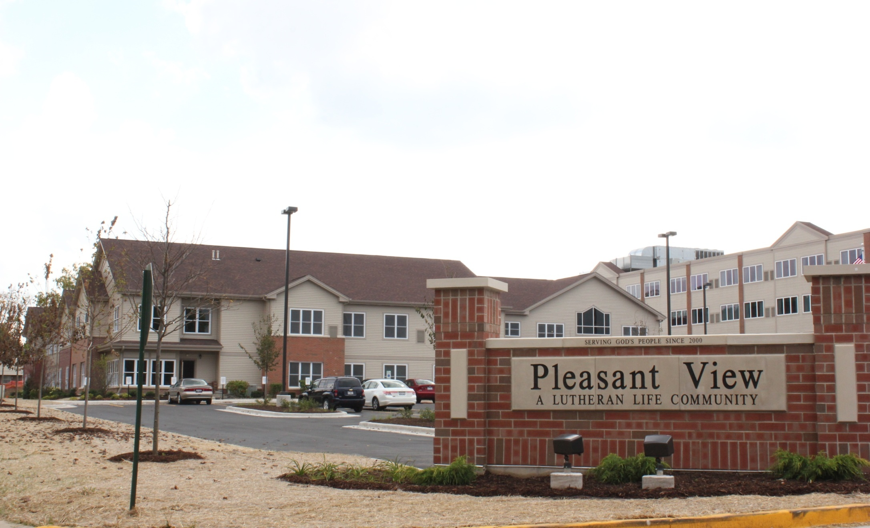

Slide 65
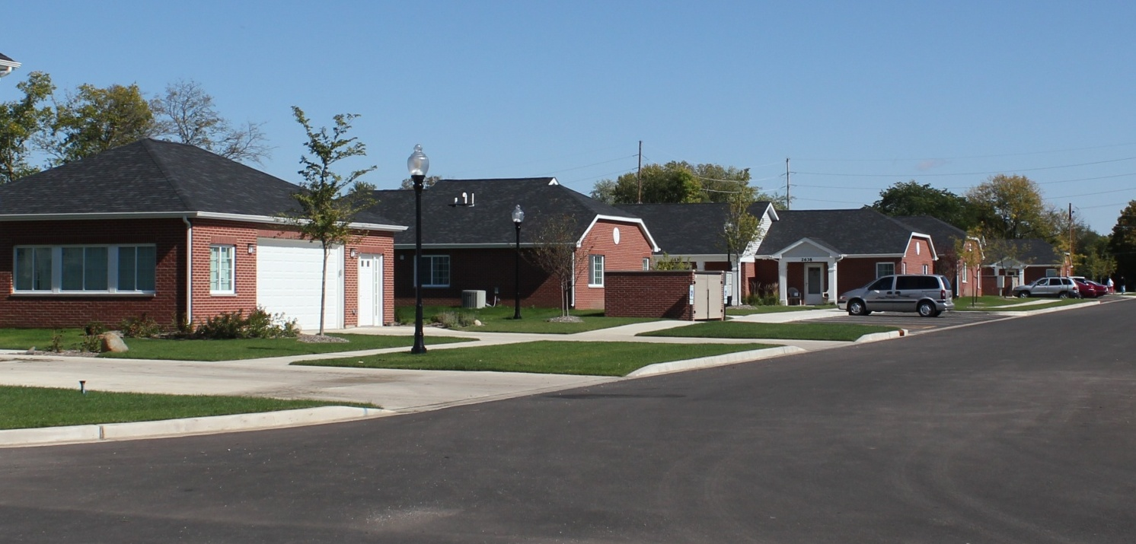
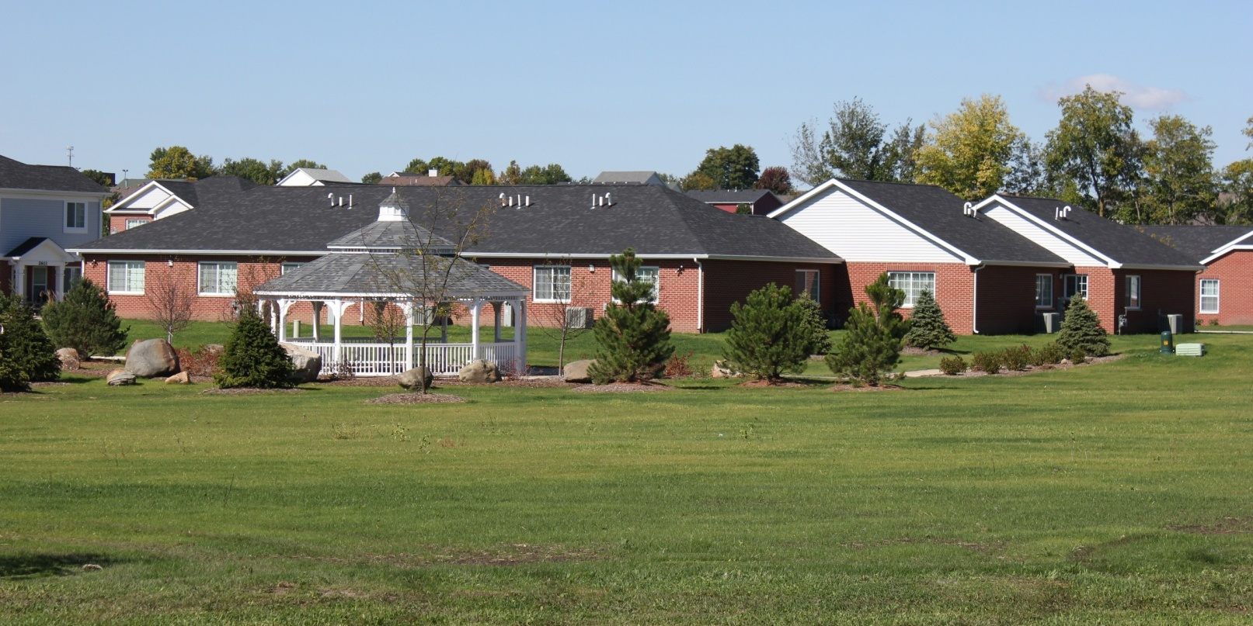
Ottawa Senior Housing

Slide 66
ECONOMIC
DEVELOPMENT STRATEGY
Ottawa Industrial Park
Retail Growth: North Side and Norris Drive
Downtown Ottawa and Downtown Waterfront

Slide 67
OTTAWA INDUSTRIAL PARK AND
NORTHSIDE INDUSTRY

Slide 70
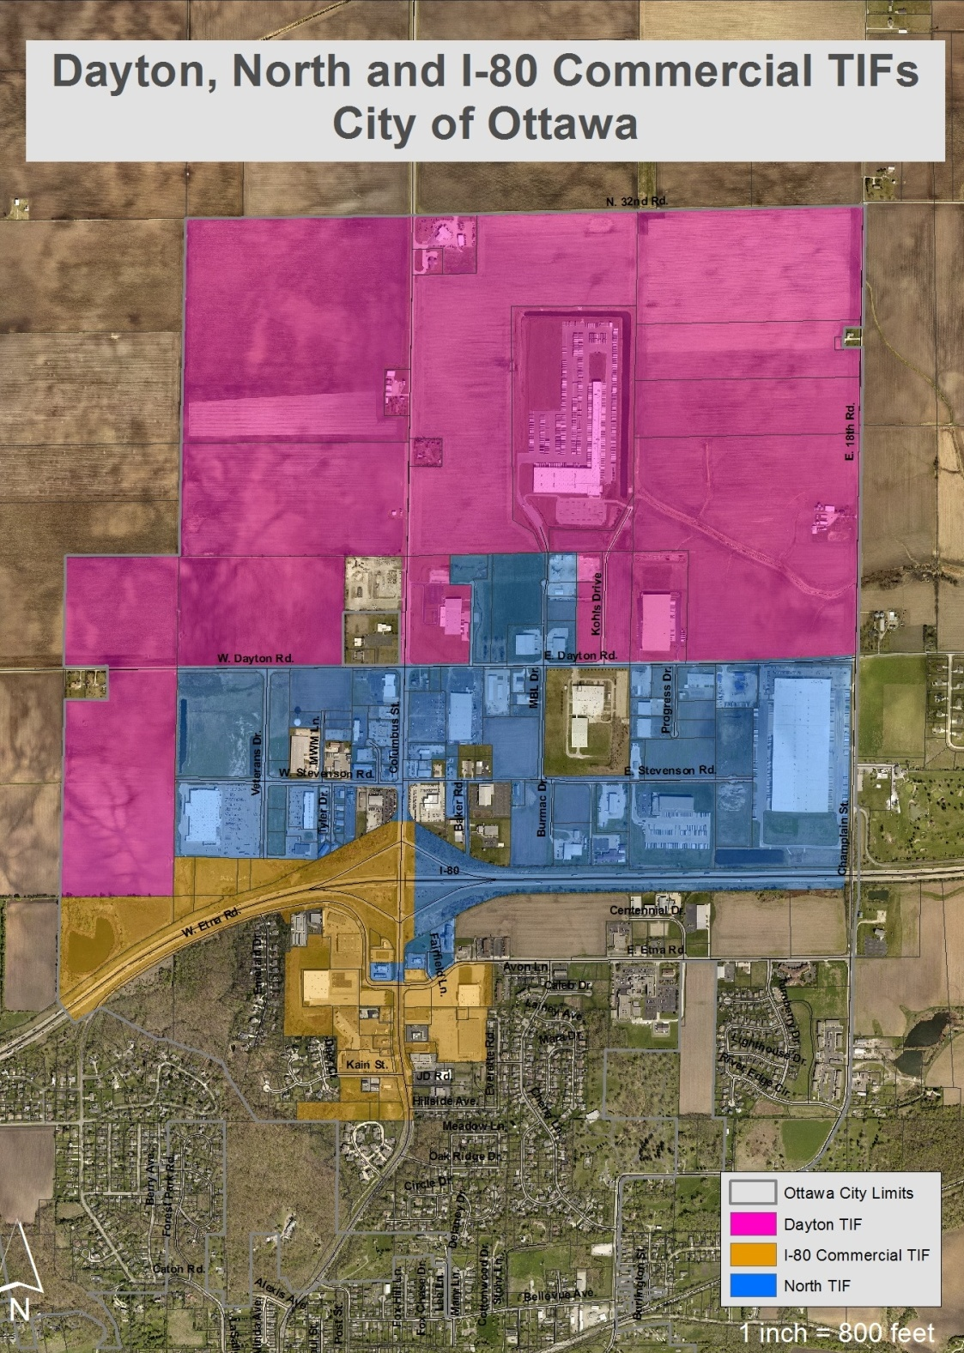

Slide 71
RETAIL GROWTH
NORTHSIDE

Slide 72
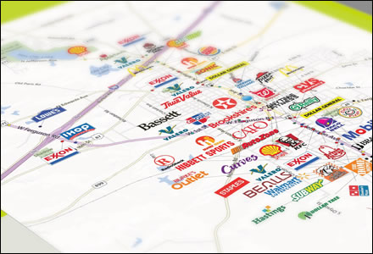
The Retail Coach

Slide 73
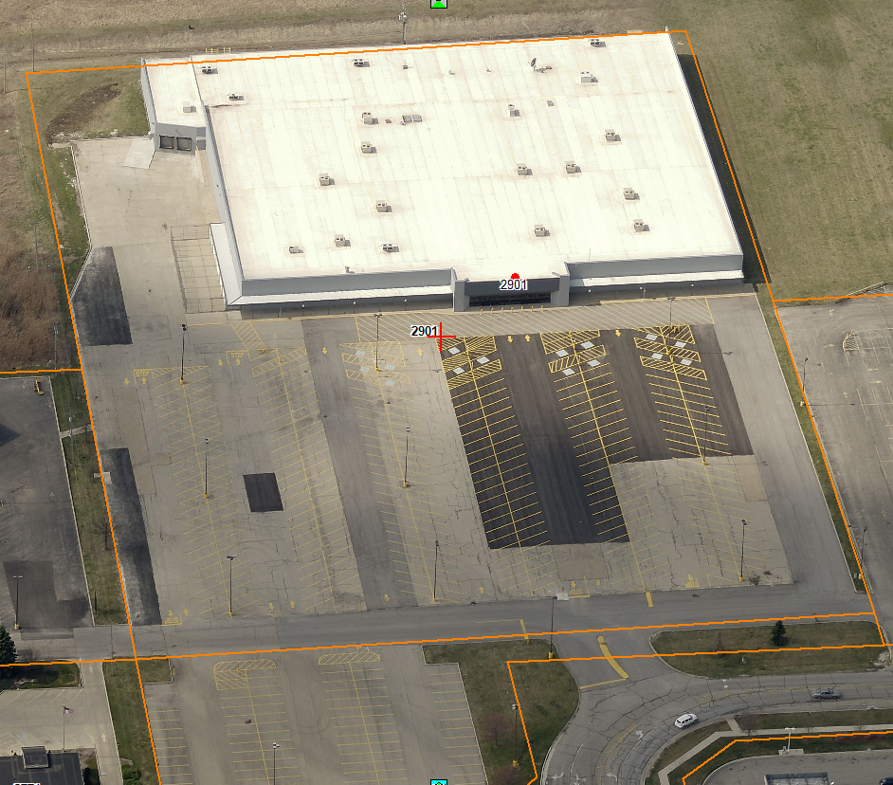
Former Wal-Mart

Slide 74
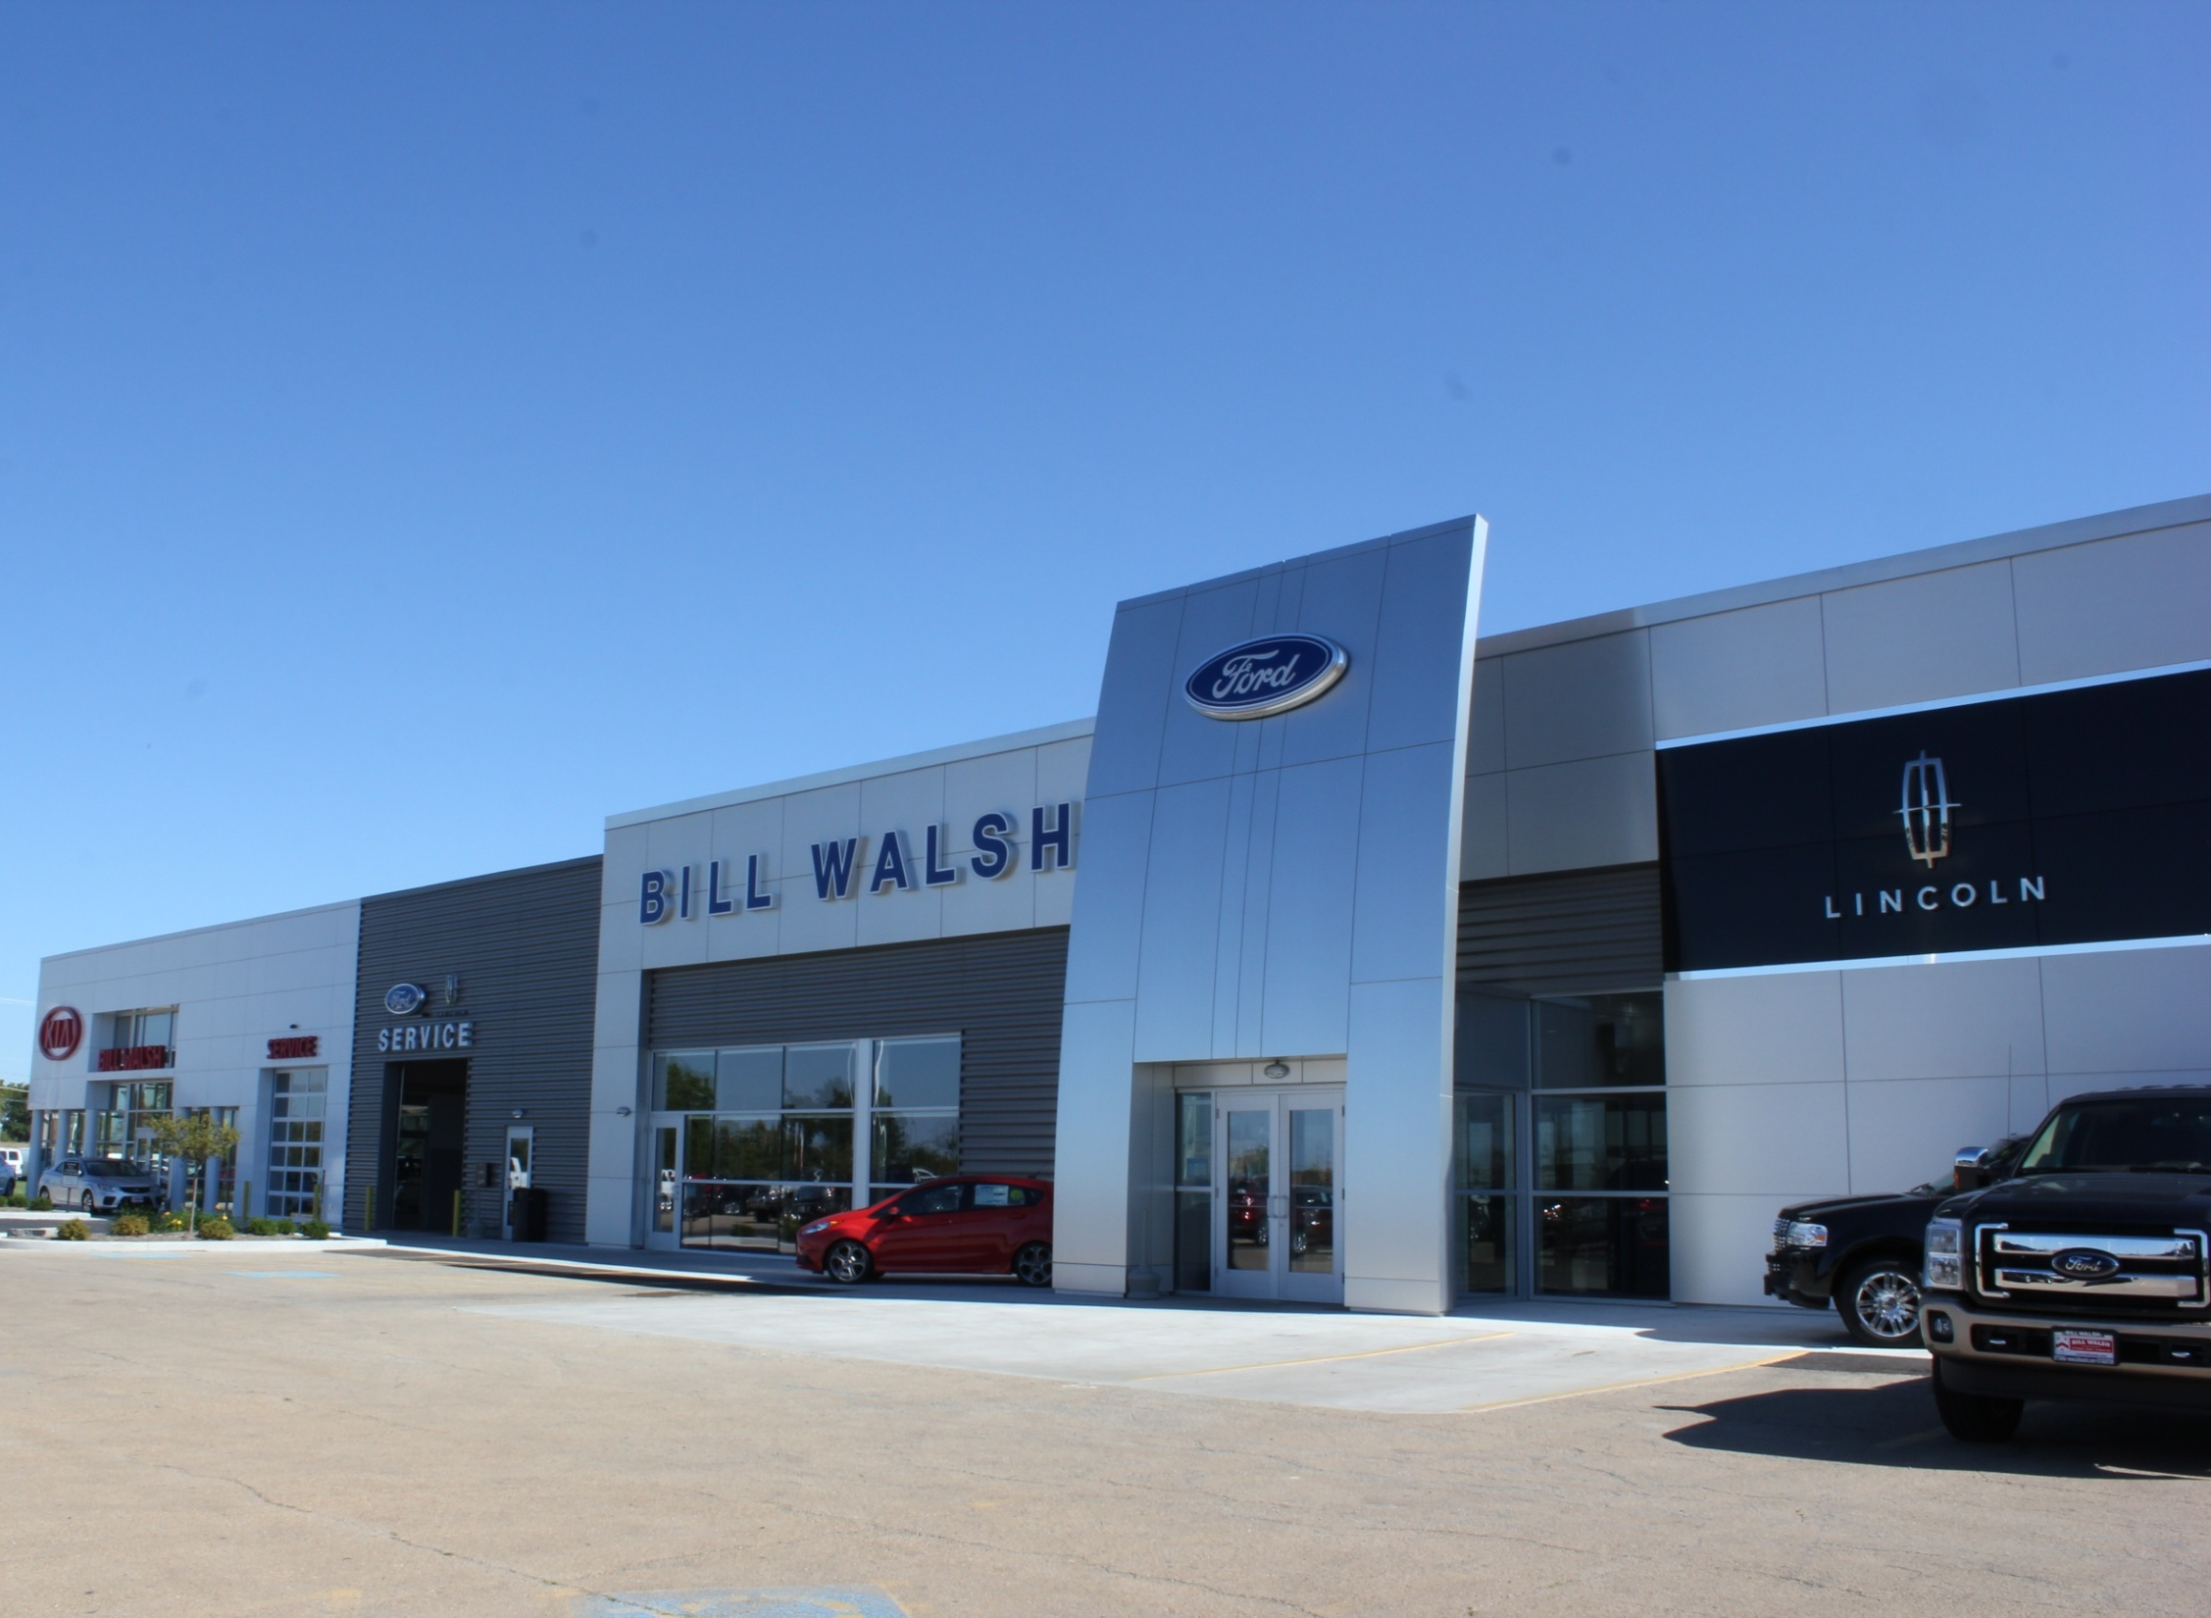

Slide 75



Slide 76
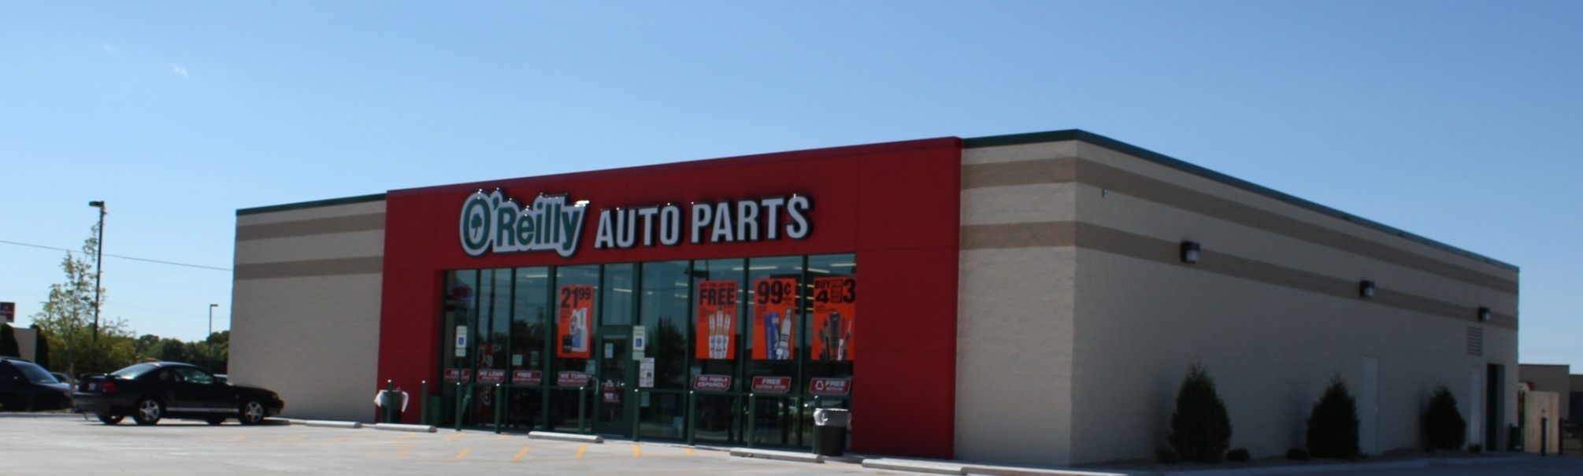
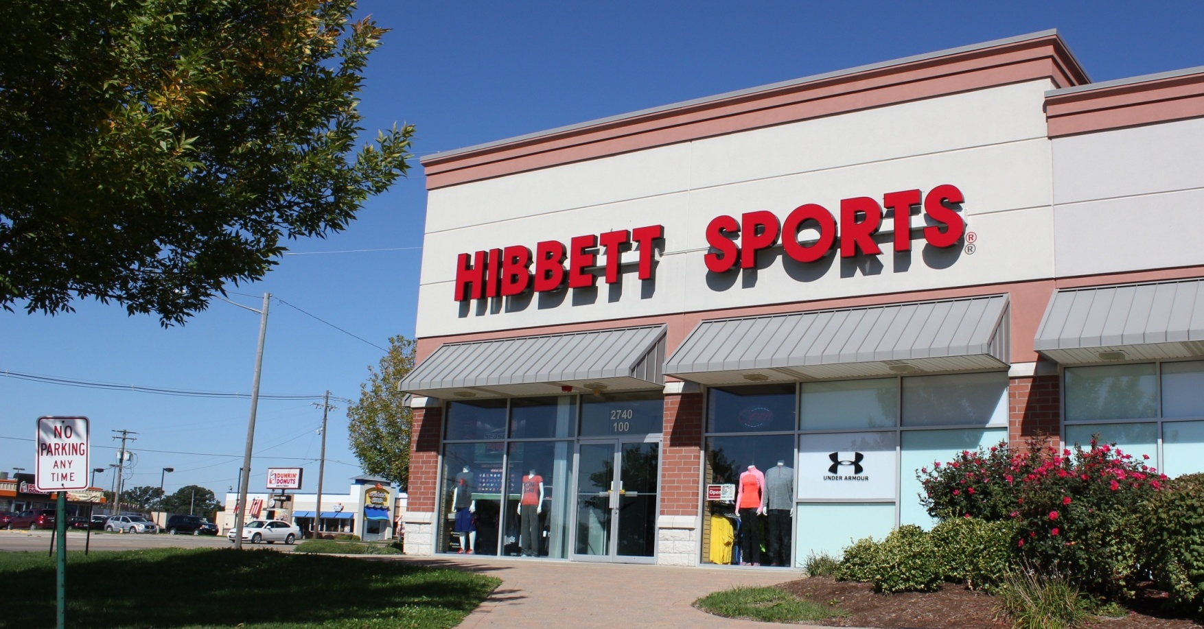

Slide 77
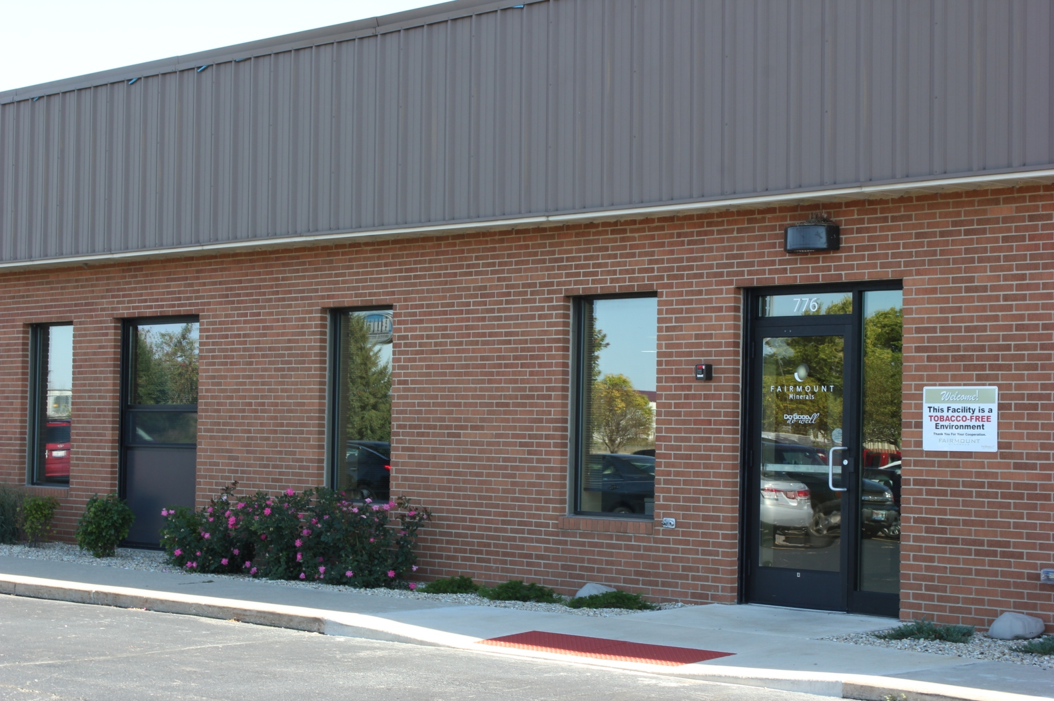
Fairmount Minerals

Slide 78

New Sidewalks

Slide 79
DOWNTOWN OTTAWA
AND
THE DOWNTOWN WATERFRONT

Slide 80


Slide 81


Slide 82


BASH
Avant Garden

Slide 83


Slide 84

Your First Stop
Shop Liquidators

Slide 85

The Fox’s Den

Slide 86

Jamaka Me Tan

Slide 87


Slide 88

Annette Barr Studios

Slide 89

Dancer’s Shoppe

Slide 90

St. Columba
Church

Slide 91

St. Columba
Church

Slide 92


Slide 93


Slide 94

ReMax

Slide 95

Occasions

Slide 96




Slide 97

Little City Building

Slide 98
Columbus Streetscape

Slide 99

Madison Street Streetscape

Slide 100
FESTIVALS

Slide 101




Slide 102

Morel Fest

Slide 103



Two Rivers Wine and
Jazz Festival

Slide 104

Riverfest

Slide 105


Scarecrow Festival and Ice Odyssey

Slide 106

Festival of Lights Parade

Slide 107
DOWNTOWN WATERFRONT

Slide 108


Slide 109

Central School Site

Slide 110


Slide 111


Slide 112


Slide 113



Master Plan – ideas?

Slide 114


Slide 115


Slide 116


Slide 117


Slide 118


Slide 119


Slide 120
Make no little plans. They have no magic to stir men's blood and probably themselves will not be realized.
Make big plans; aim high in hope and work, remembering that a noble, logical diagram once recorded will never die.
Daniel Burnham, Chicago architect and planner. (1846-1912)

Slide 121


Reddick
Mansion

Slide 122


Slide 123

Re-Watering I & M Canal

Slide 124
HISTORIC NEIGHBORHOODS

Slide 125



East Side Historic National Register Nomination

Slide 126

West Side Historic Survey

Slide 127
DAYTON BLUFFS
NATURE PRESERVE

Slide 128

Site Map

Slide 129

Friday, October 18th
5pm to 9pm

Slide 130
HERITAGE HARBOR OTTAWA

Slide 131

Heritage Harbor Ottawa

Slide 132


Slide 133


Cottages at Heron’s Landing

Slide 134

Ottawa Visitors Center

Slide 135
ILLINOIS RIVER ROAD NATIONAL SCENIC BYWAY

Slide 136



Slide 137
STARVED ROCK COUNTRY

Slide 138




Slide 139
OTTAWA IS BLOOMING

Slide 140

America In Bloom

Slide 141


America In Bloom

Slide 142


Slide 143


Slide 144

America in Bloom symposium

Slide 145


Slide 146


Slide 147


Slide 148


Slide 149


Slide 150


Slide 151


Slide 152


Slide 153


Slide 154


Slide 155


Slide 156


Slide 157


Slide 158
CITY FINANCES

Slide 159
TOTAL BUDGET
$43 MILLION
GENERAL CORPORATE
$14.6 MILLION

Slide 160

Payroll

Slide 161

Budgeting

Slide 162
$165,000 in reimbursements from FEMA for eligible expenses incurred from
April, 2013 flood.

Slide 163

Health Plan

Slide 164
Grant applications received:
Columbus Streetscape $ 800,000
Main Street Streetscape $ 99,000
NCAT Bus Barn $ 500,000
NCAT Technical Grant $ 50,000
NCAT Capital Improvements $1,200,000
Phase II of Tree Grant $ 131,000
Street Light Energy Grant $ 12,000
Comprehensive Plan Update $ 100,000
West Side Building Survey $ 11, 270
Total $2,903,000

Slide 165
Grant applications administering:
Fox River/Flats Buy-Out $ 914,000
Fox River/Flats Additional DNR $ 58,000
Illinois Valley Commuter Rail $ 395,000
Central School Buy-Out $2,000,000
USEDA Grant for OIP, Unit 2 $2,000,000
USEPA Brownfield Assessment $ 350,000
TOTAL $5,717,000

Slide 166
Grant applications pending:
Route 80 Pedestrian Bridge $ 1,700,000
IKE Grant for OIP, Unit 2 $ 1,100,000
Trails Access Bridge over I&M Canal $ 200,000
TOTAL $ 3,000,000

Slide 167
ILLINOIS VALLEY COMMUNITY COLLEGE OTTAWA CENTER

Slide 168

IVCC Ottawa Center

Slide 169
CONCLUSION

